Slide 1
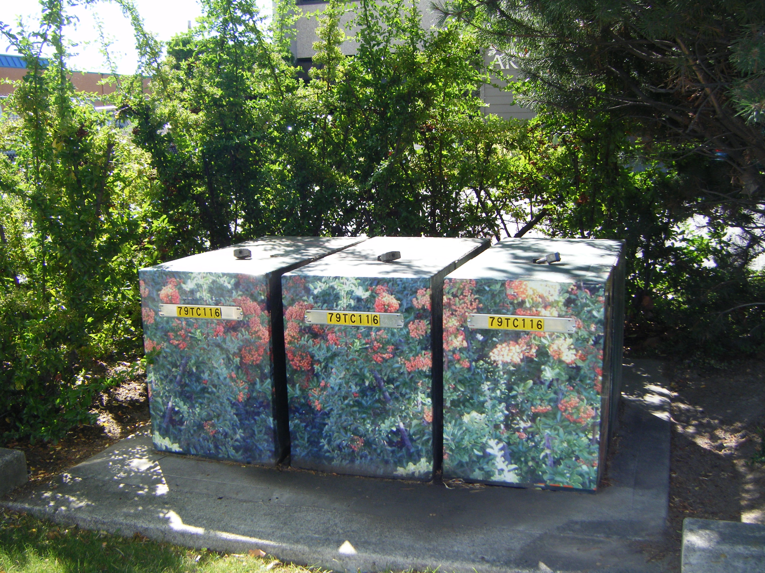
Notes:
Are these sculptures or electric boxes? They are at once functional and yet beautiful. I discovered them while on vacation in Kelowna B.C. at the 3000 block of Tutt Street.

Slide 2
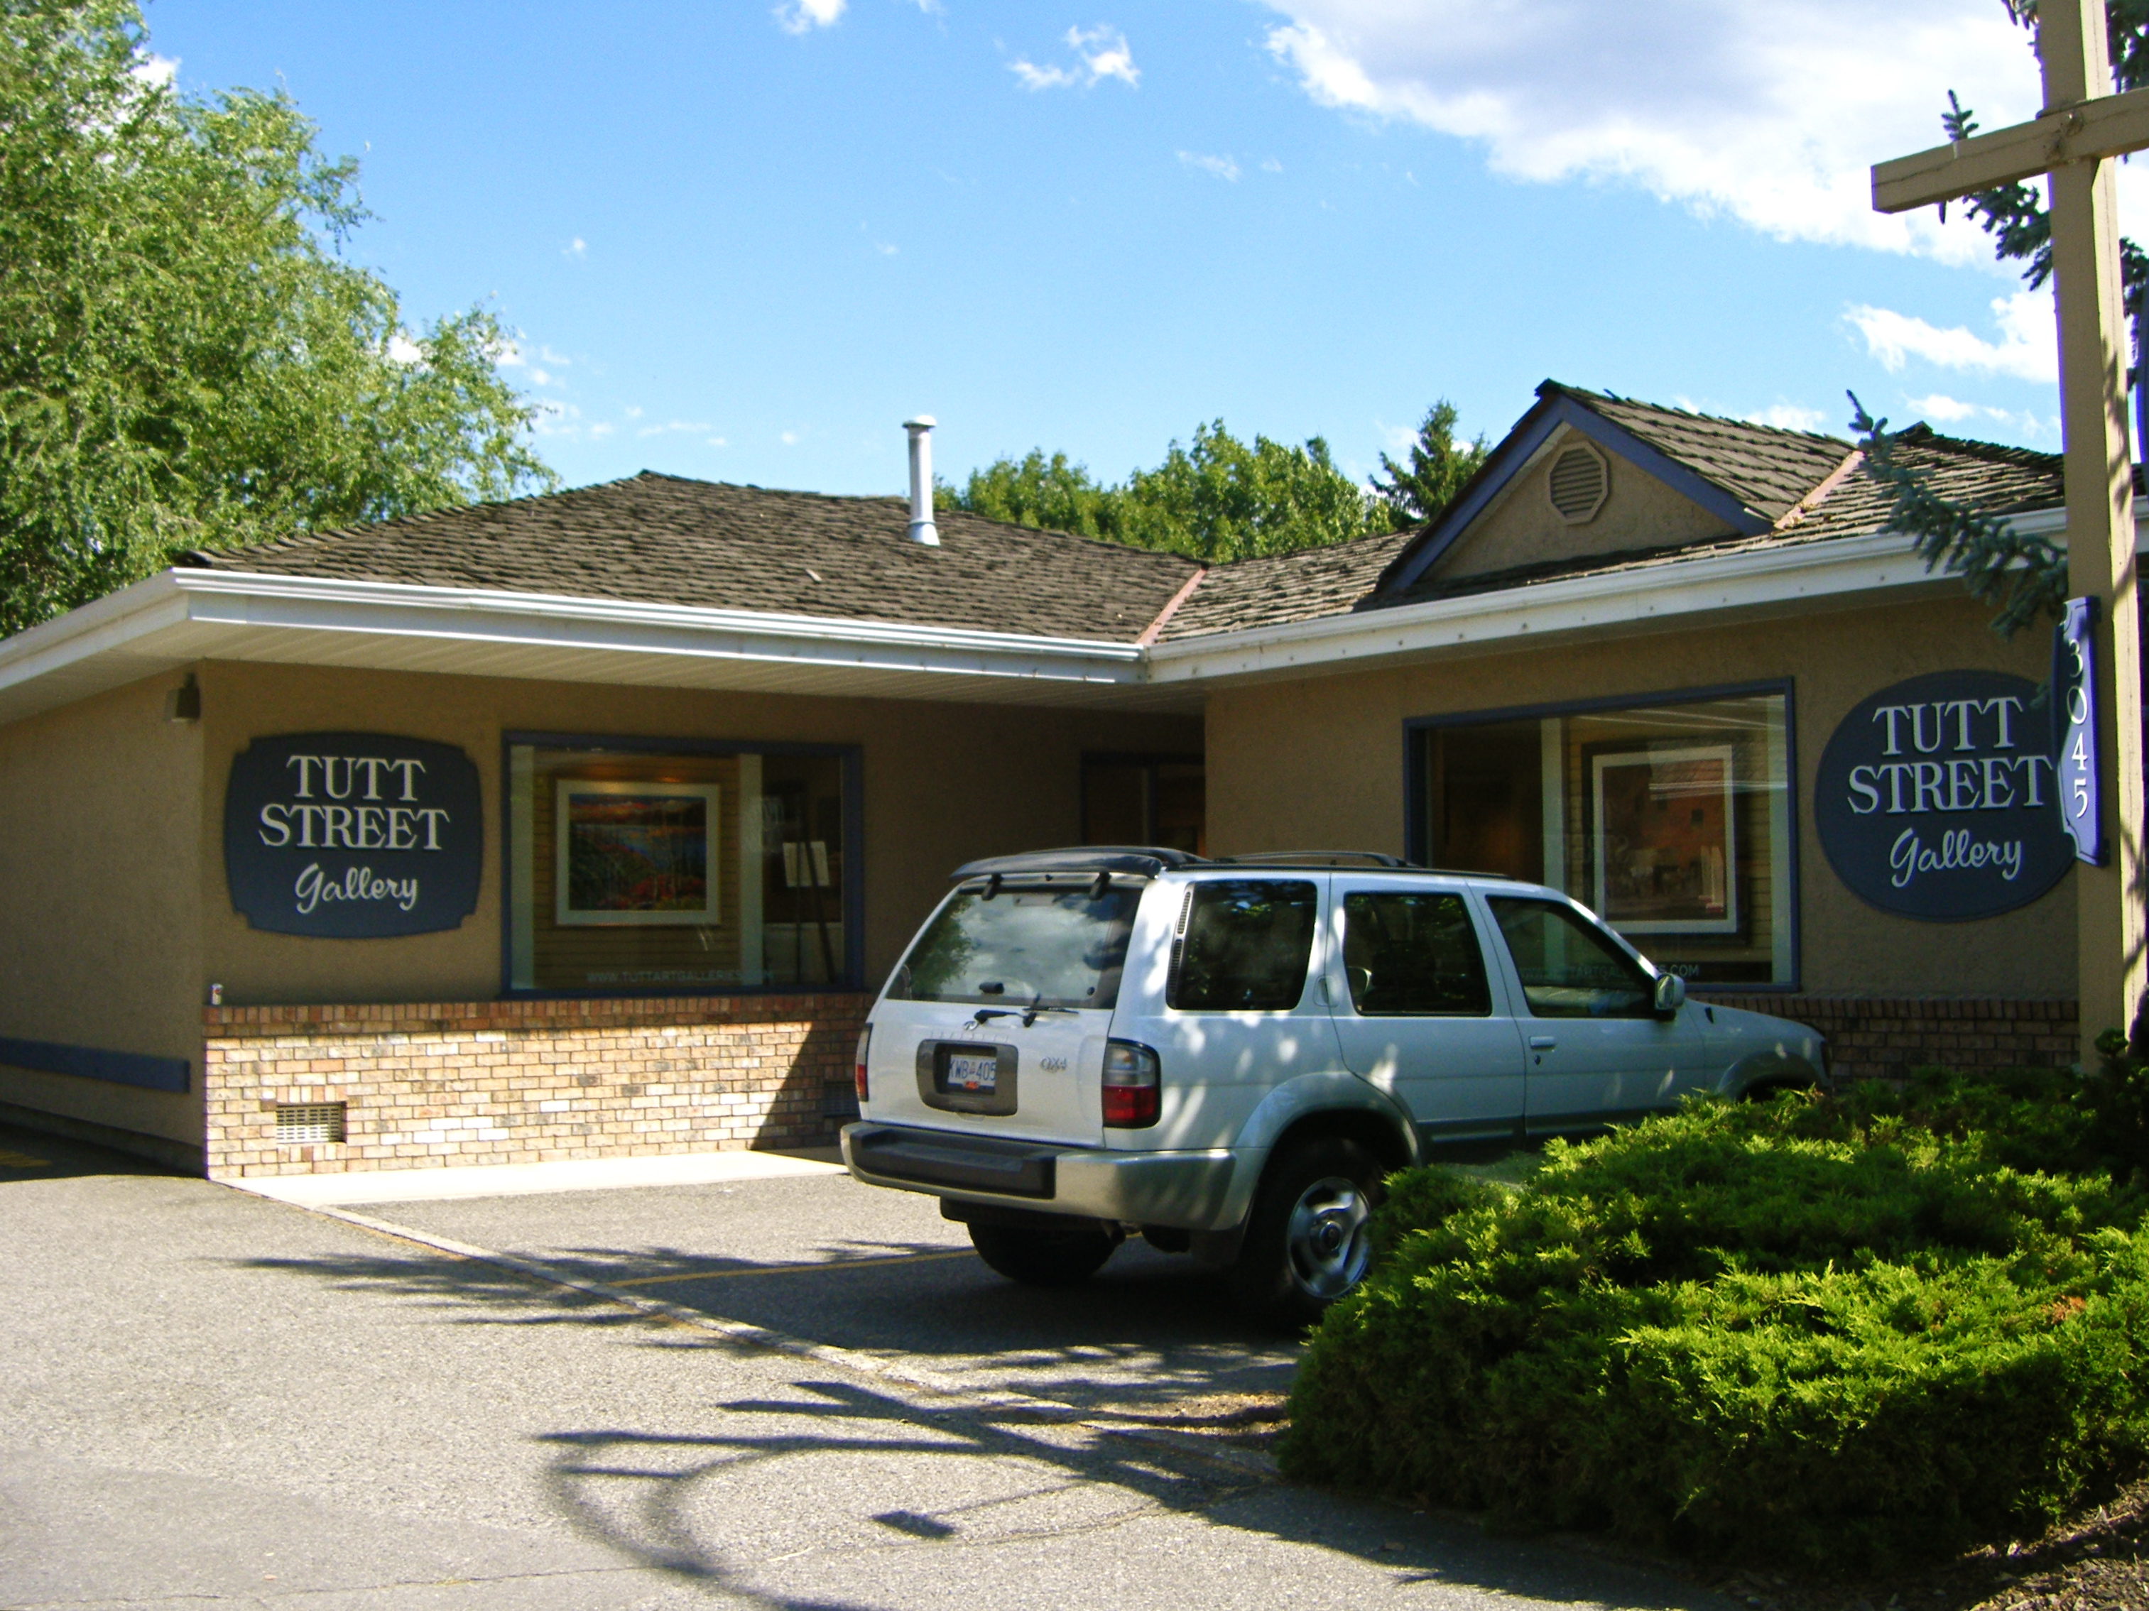
Notes:
I am an artist and I visit galleries when I travel. I also studied public art while doing a degree in Fine Arts at Concordia University in Montreal. Tutt Street Gallery in Kelowna, B.C. sent me to the Park’s Administration to discover why graphic art was put on electric boxes, garbage cans, recycling containers etc. I wanted to know who was the artist or committee that made it happen.

Slide 3
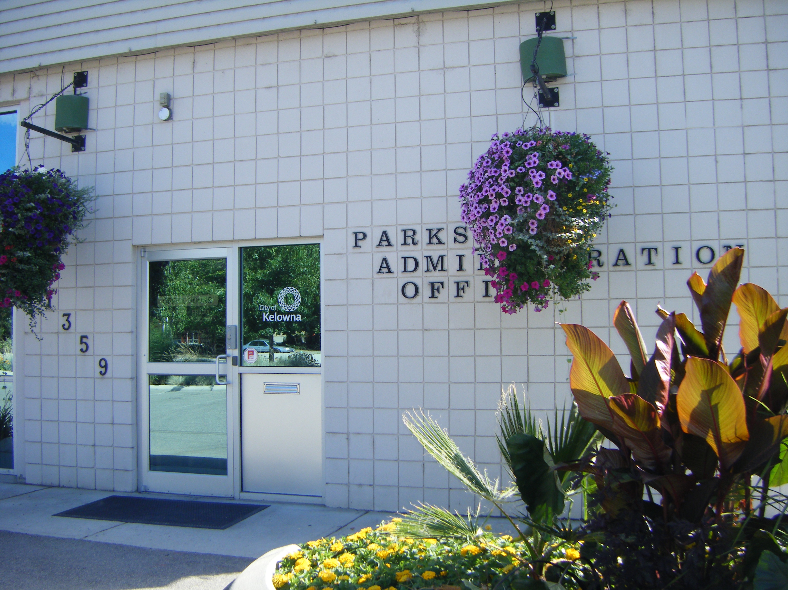
Notes:
I got in the car and went to meet the man behind the project but I arrived after hours. Later I spoke with him on the phone.
" It is an ongoing project that started many years ago," the manager of the project told me.
Public Works Parks Administration Office 1359 KLO Rd. Offices
open M-F 8 am -3:30 pm.(Offices closed when I arrived)

Slide 4
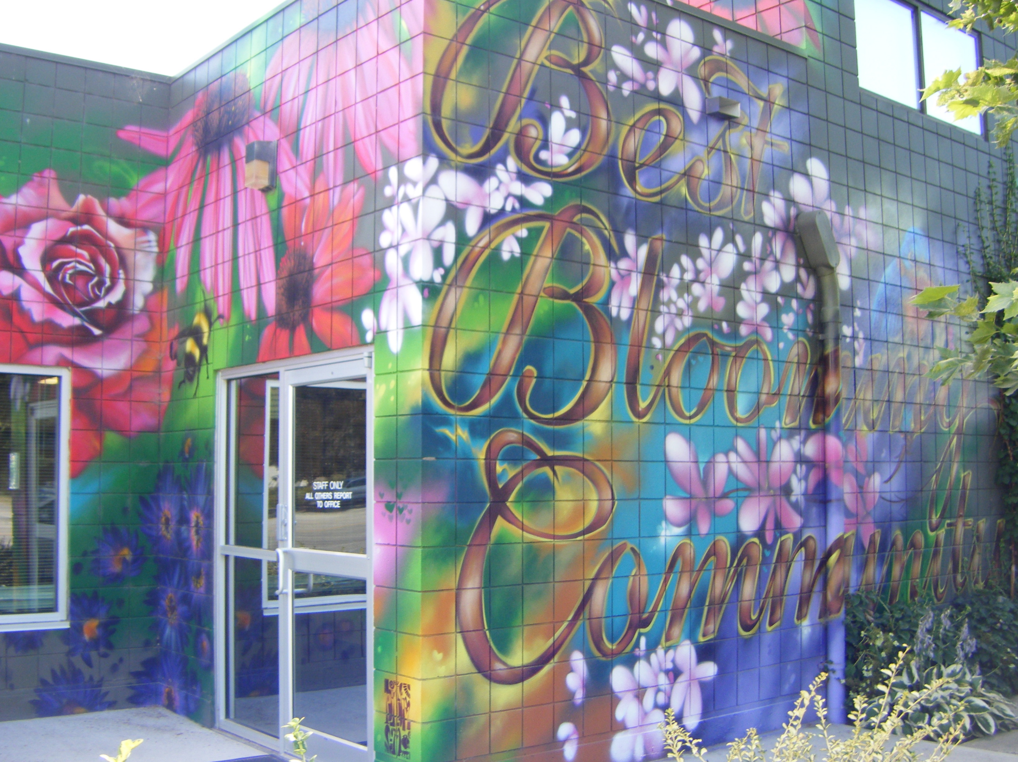
Notes:
Kelowna is the second largest city in British Columbia after Vancouver. It is spread out beside Okanagan Lake on a plateau in the southern interior of the province. The public works office wall mural claims Kelowna is The Best Blooming Community. Agriculture and Tourism have kept it alive. When once there were less profitable and labour intensive orchards everywhere, now there are hundreds of vineyards around the lake. Along with a unique atmospheric lighting, these give the region the appearance of a southern French landscape.
Public Works Office 1359 KLO Rd, .Kelowna B.C.
Offices open M-F 8 am -3:30 pm.

Slide 5
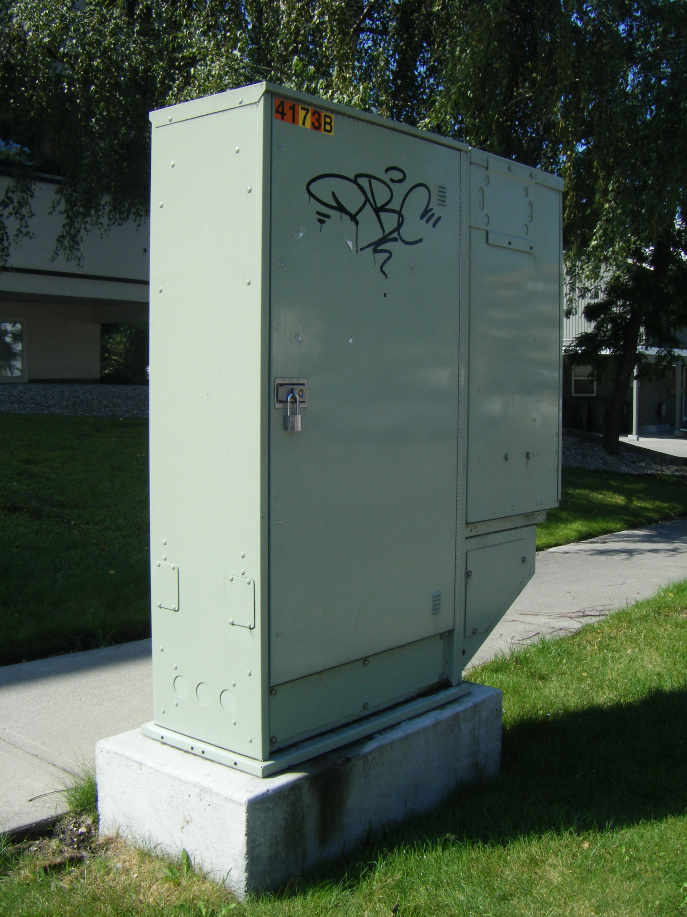
Notes:
How unappealing is this "tagging" ? And what about the electric box? When I spoke with him on the phone, the manager of the public art project, Scott Isfan of the Kelowna Parks & Recreation Department said the city was trying to find ways to keep this undesireable type of grafitti off traffic boxes. Later the focus was on these electric boxes. So Kelowna used $50,000 to hire the Vancouver Premier Graphics Company who does Saputo truck advertising with 3M air release vinyl photos. The wraps keep the city from having to send out grafitti cleaners 15 times a year for each box. To remove grafitti is very costly to taxpayers. So the city worker said over the phone when I interviewed him in the summer of 2012. "We had a city budget for our own city electric company and now we have a bylaw to require the FORTIS company to provide vinyl wraps for their new boxes."

Slide 6
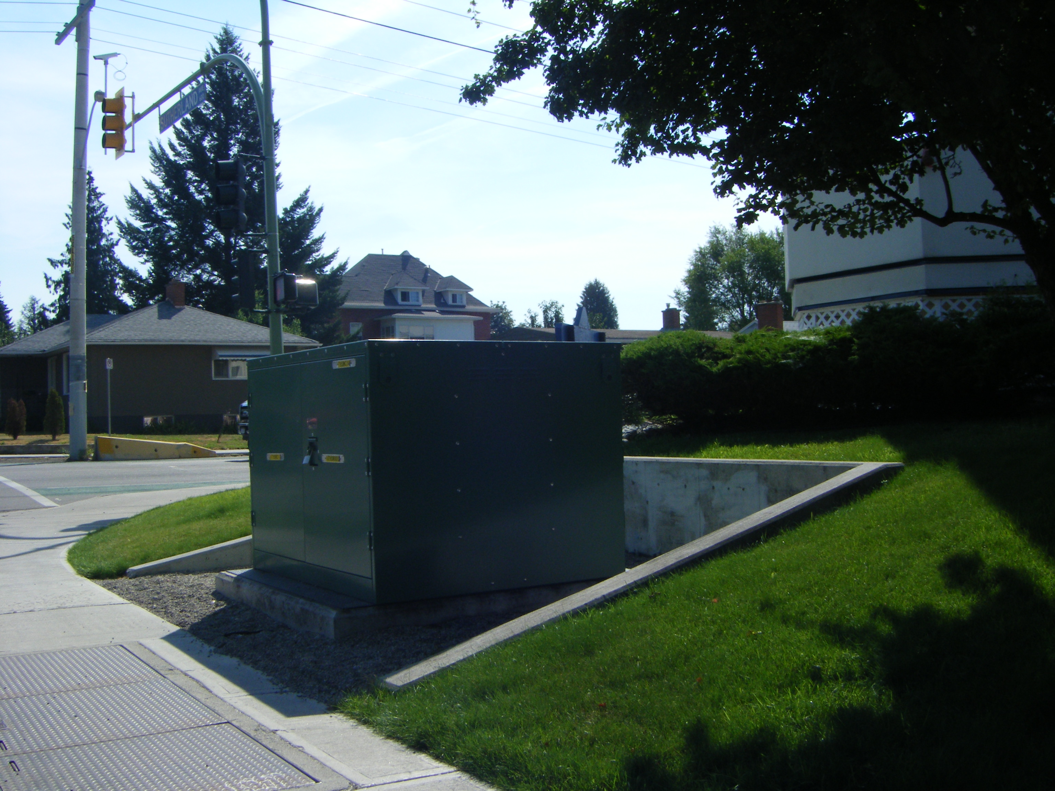
Notes:
"I had black and white museum archive photos for traffic boxes", says Isfan, "but I got my fruit packing company idea from the Beautiful BC magazine’s special feature edition of cover pages since 1954. This helped me do the electric boxes and other boxes near buildings and in the parks where most of the vandalism occurs. The designs were best presented in a postcard book at the packing house museum. We measured each box and sent the information to the graphic artists and they were mass produced." I thought to myself, it appeared Canada Post had the same idea when they added a motif to their mailboxes.

Slide 7
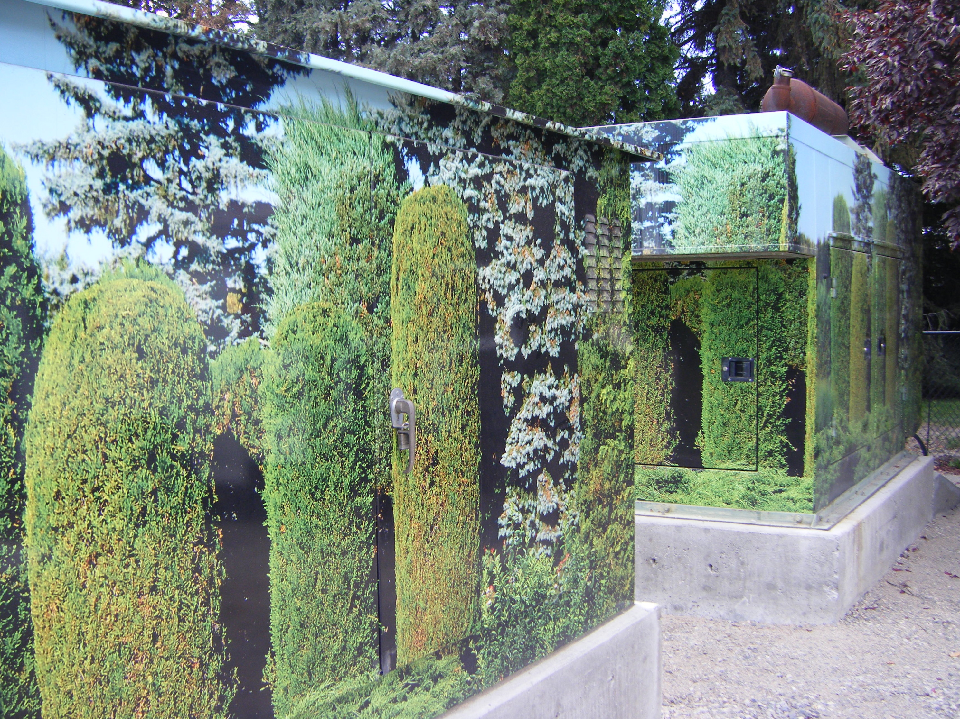
Notes:
With a Fuji 'point and shoot' camera and a borrowed vehicle, I started a serious discovery of Kelowna public art here at the corner of Raymer and Gordon Drive where "greenery" is continued to the street corners. When the city was concerned that the tagging artists might abuse their property, they made their own art,and they used this inexpensive graphic art to print on vinyl. It only needs a hairdryer to activate the glue when applying. It keeps electric boxes and generators cool since variation in colour distributes sun along the sides of the boxes. An added bonus -the Okanagan Valley’s history, industry and landscape are remembered through public art on its street corners.

Slide 8
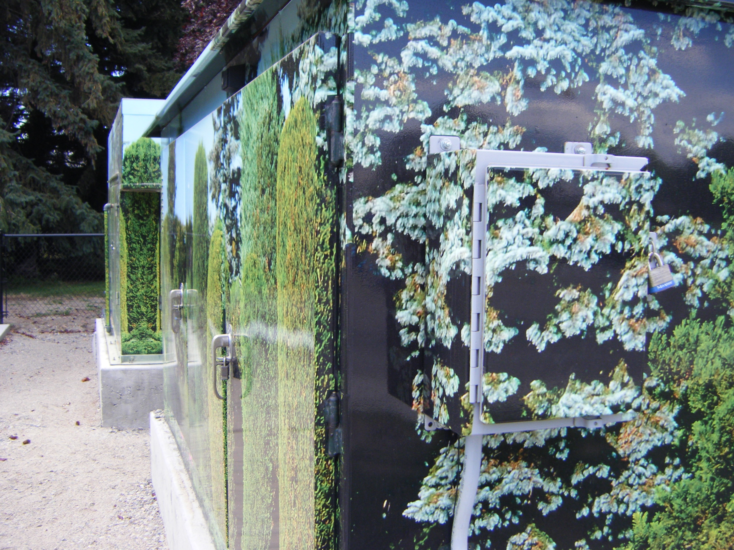
Notes:
Gordon Dr. and Raymer Ave.

Slide 9
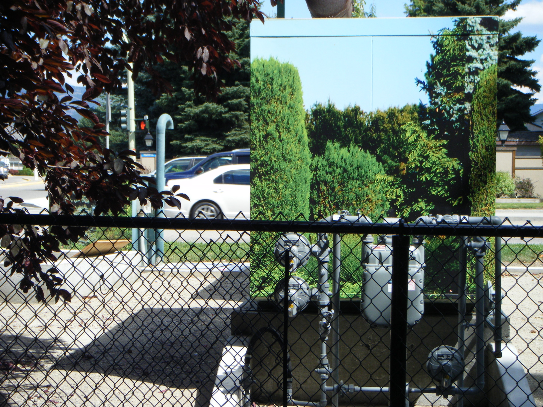
Notes:
Facing Gordon Dr.

Slide 10
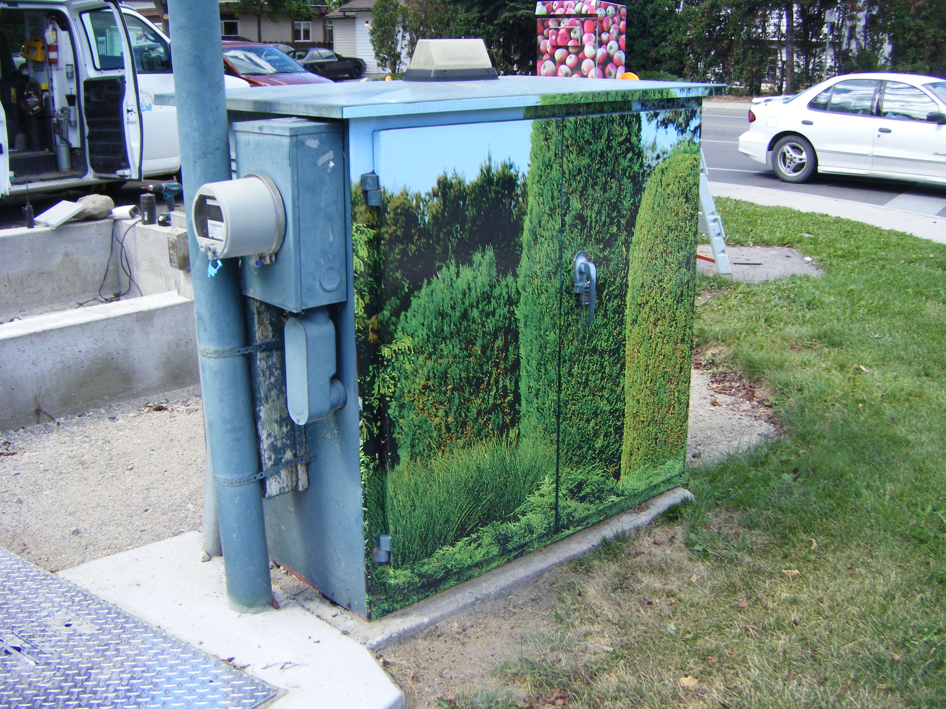
Notes:
Facing Raymer Ave.

Slide 11
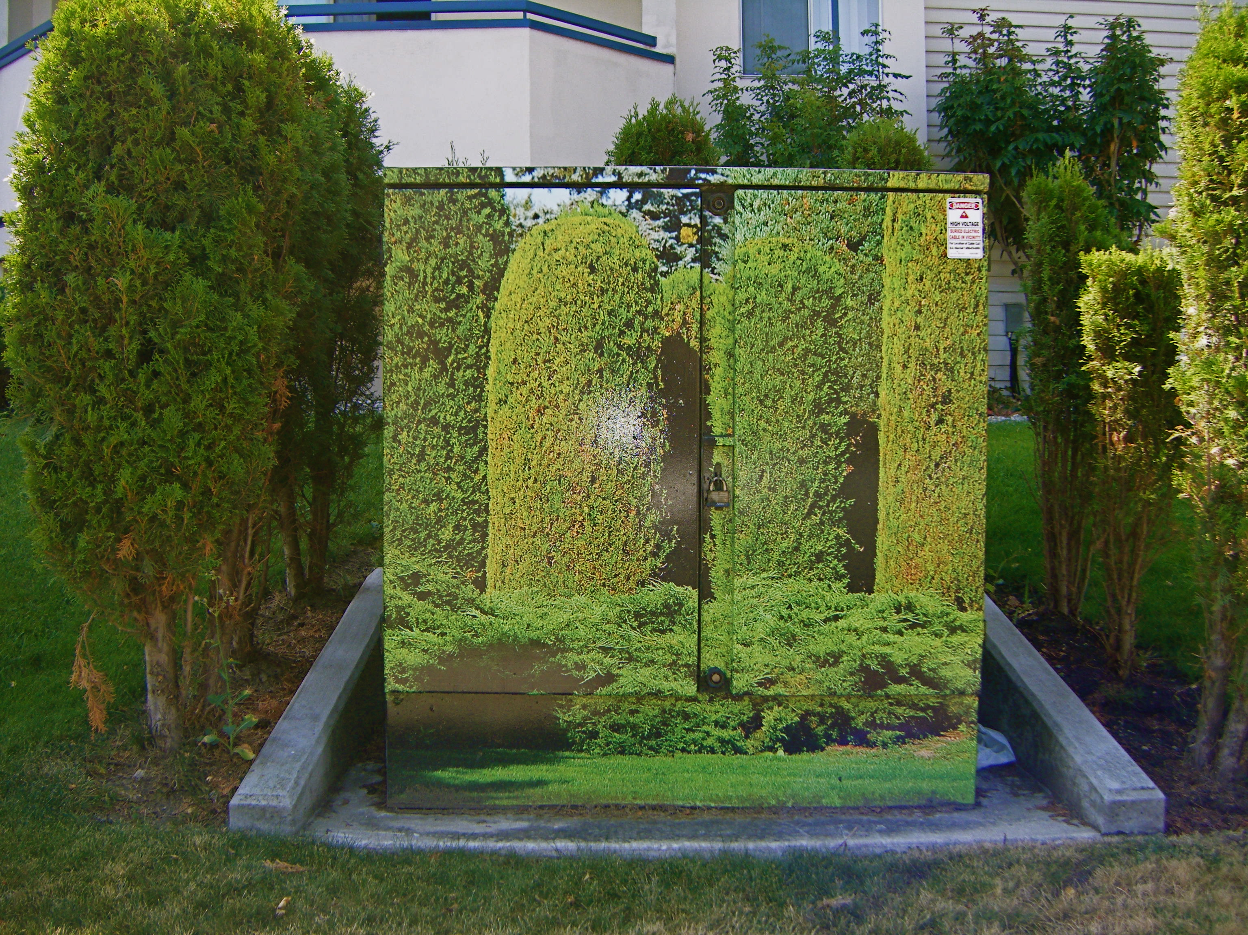
Notes:
Fitting in. "It's not easy being green," says Kermit the Frog of Muppet fame.

Slide 12
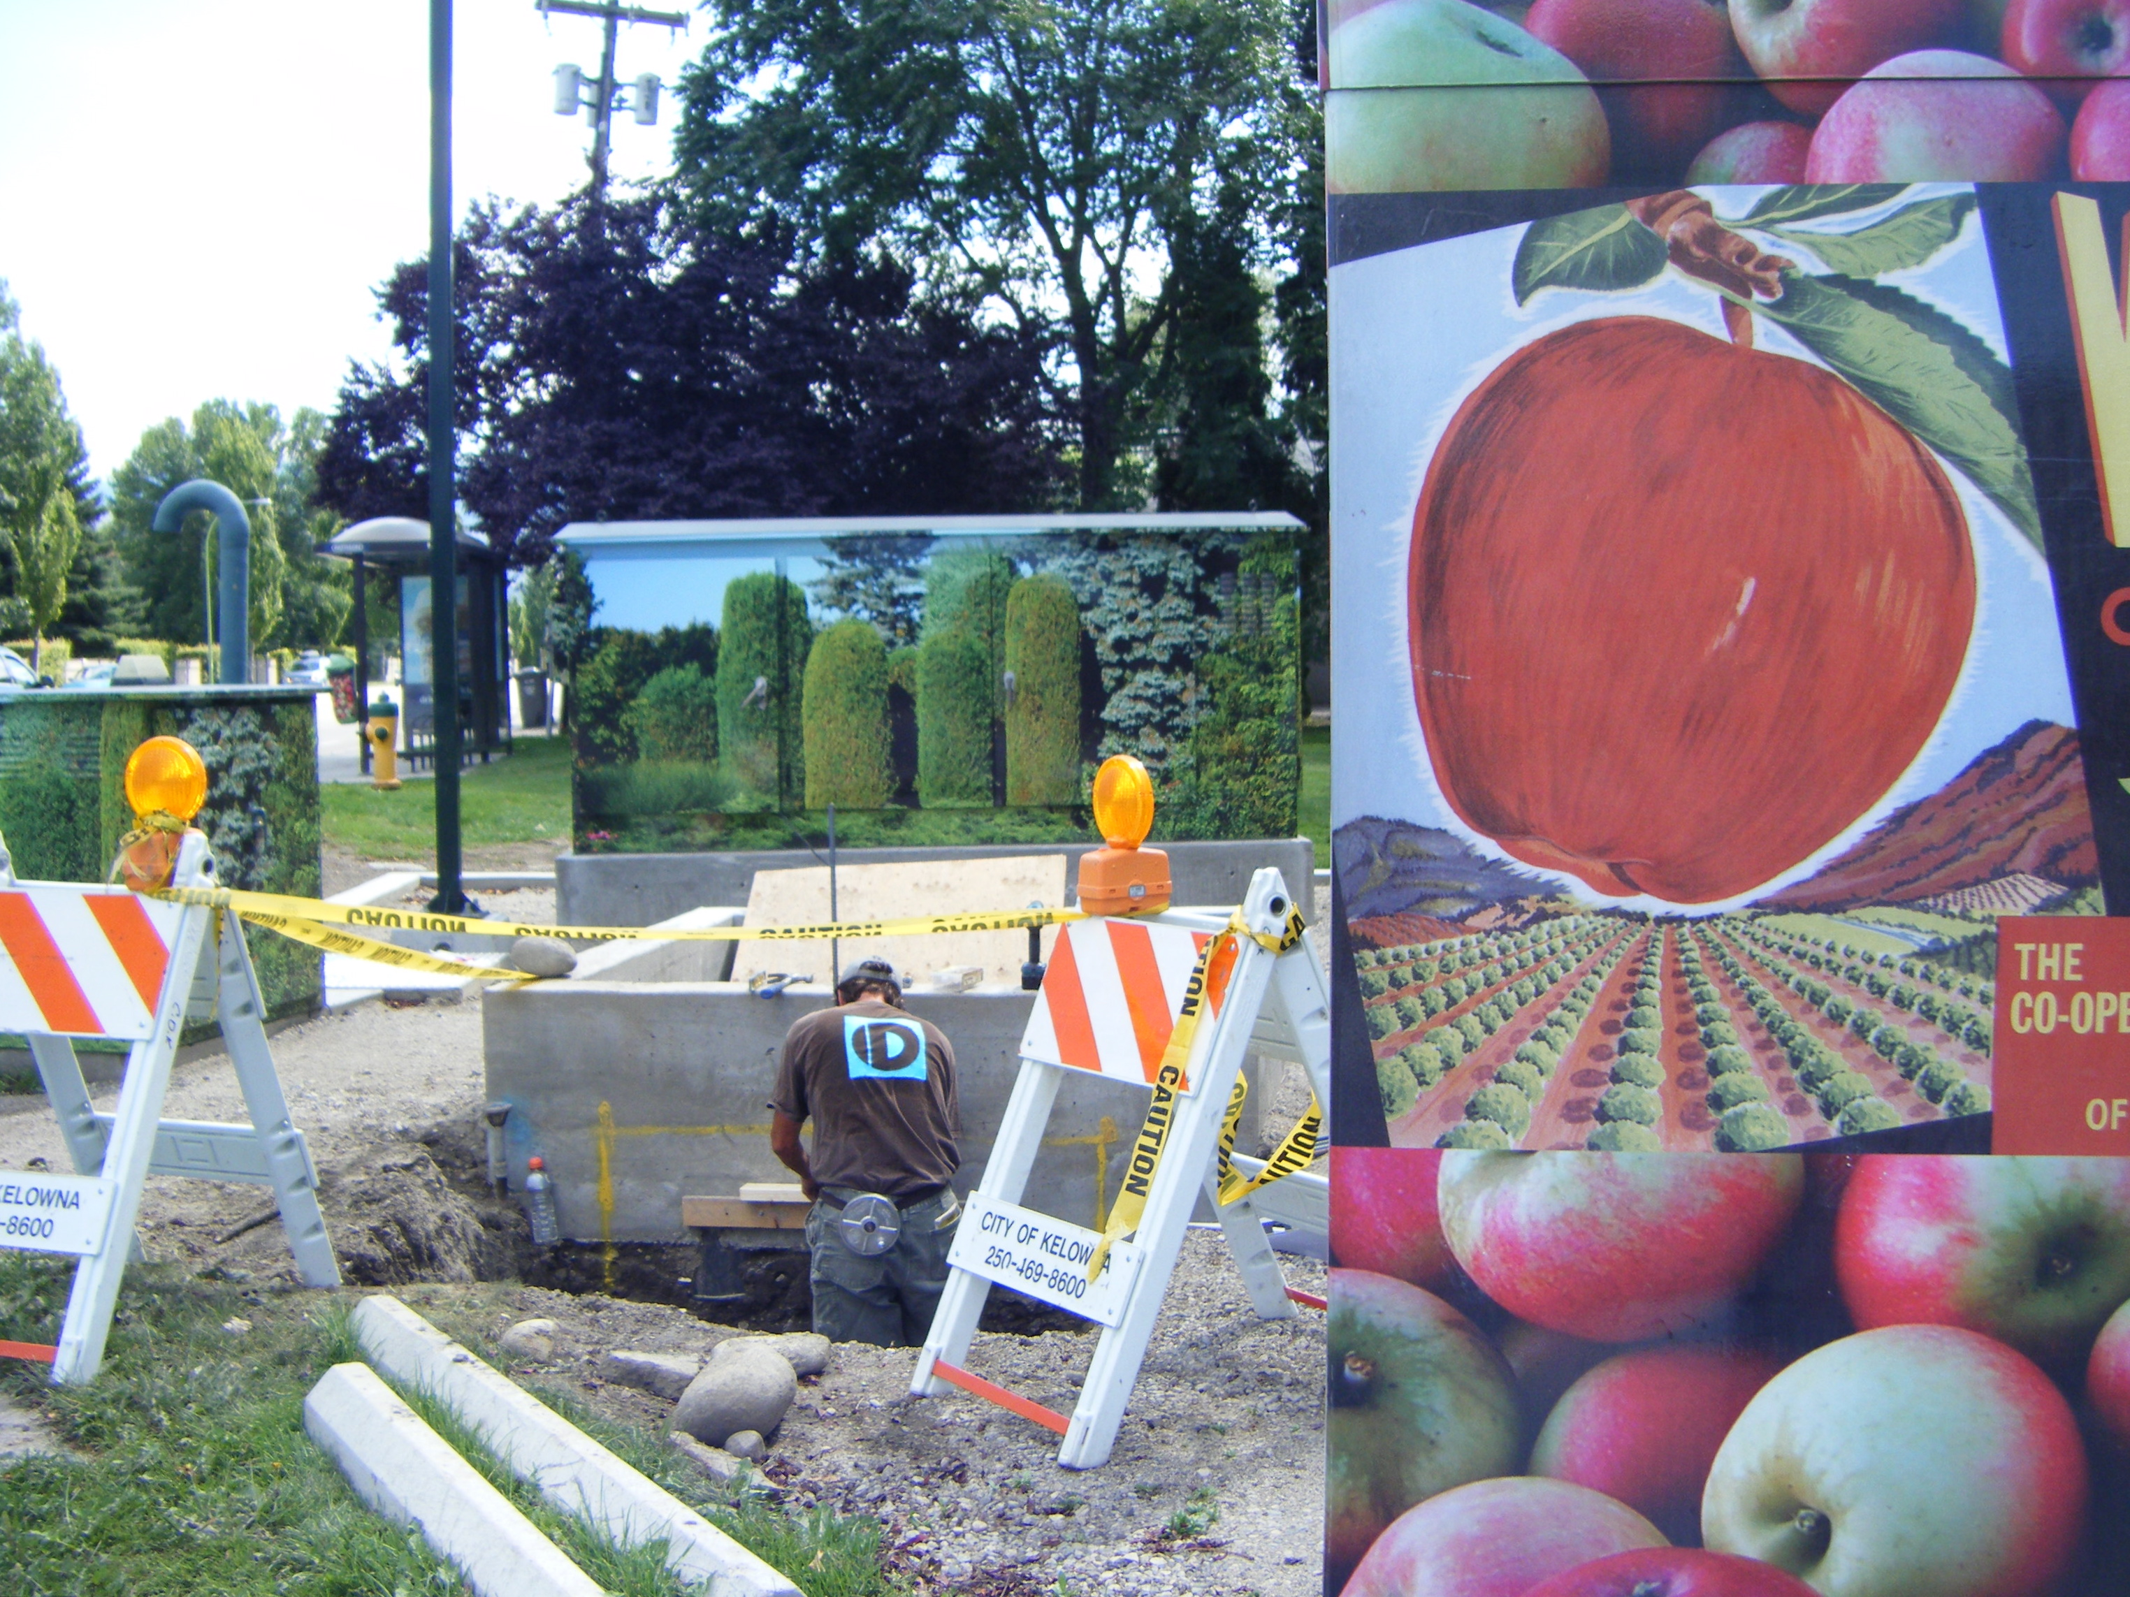
Notes:
Electric repairs are being done in front of a box with cedar tree reproductions and a box with Macintosh apple box reproductions. I decided to interview the man in the photo.
Gordon Dr. and Raymer.Ave.

Slide 13
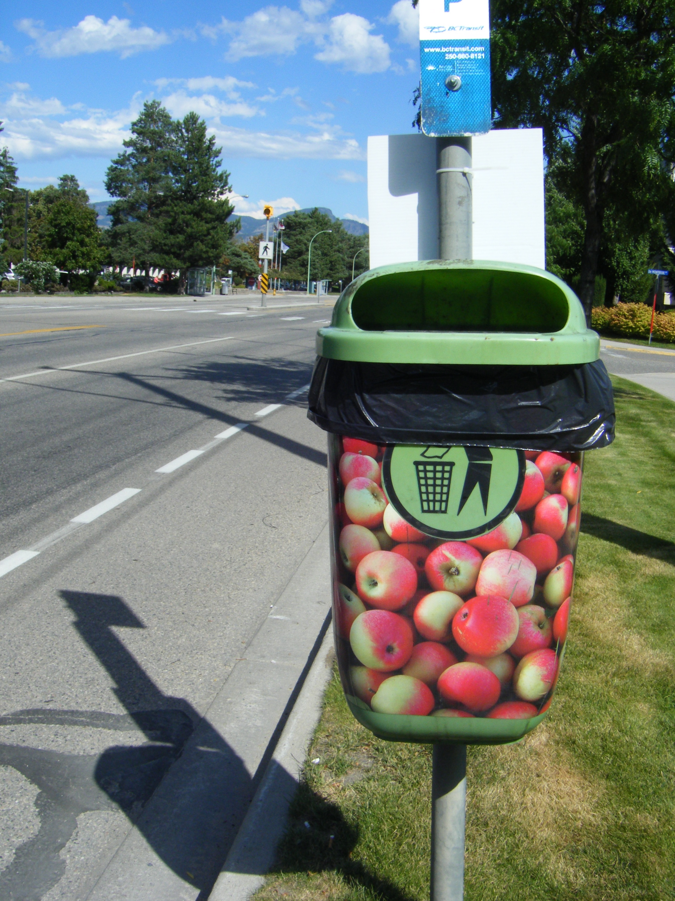
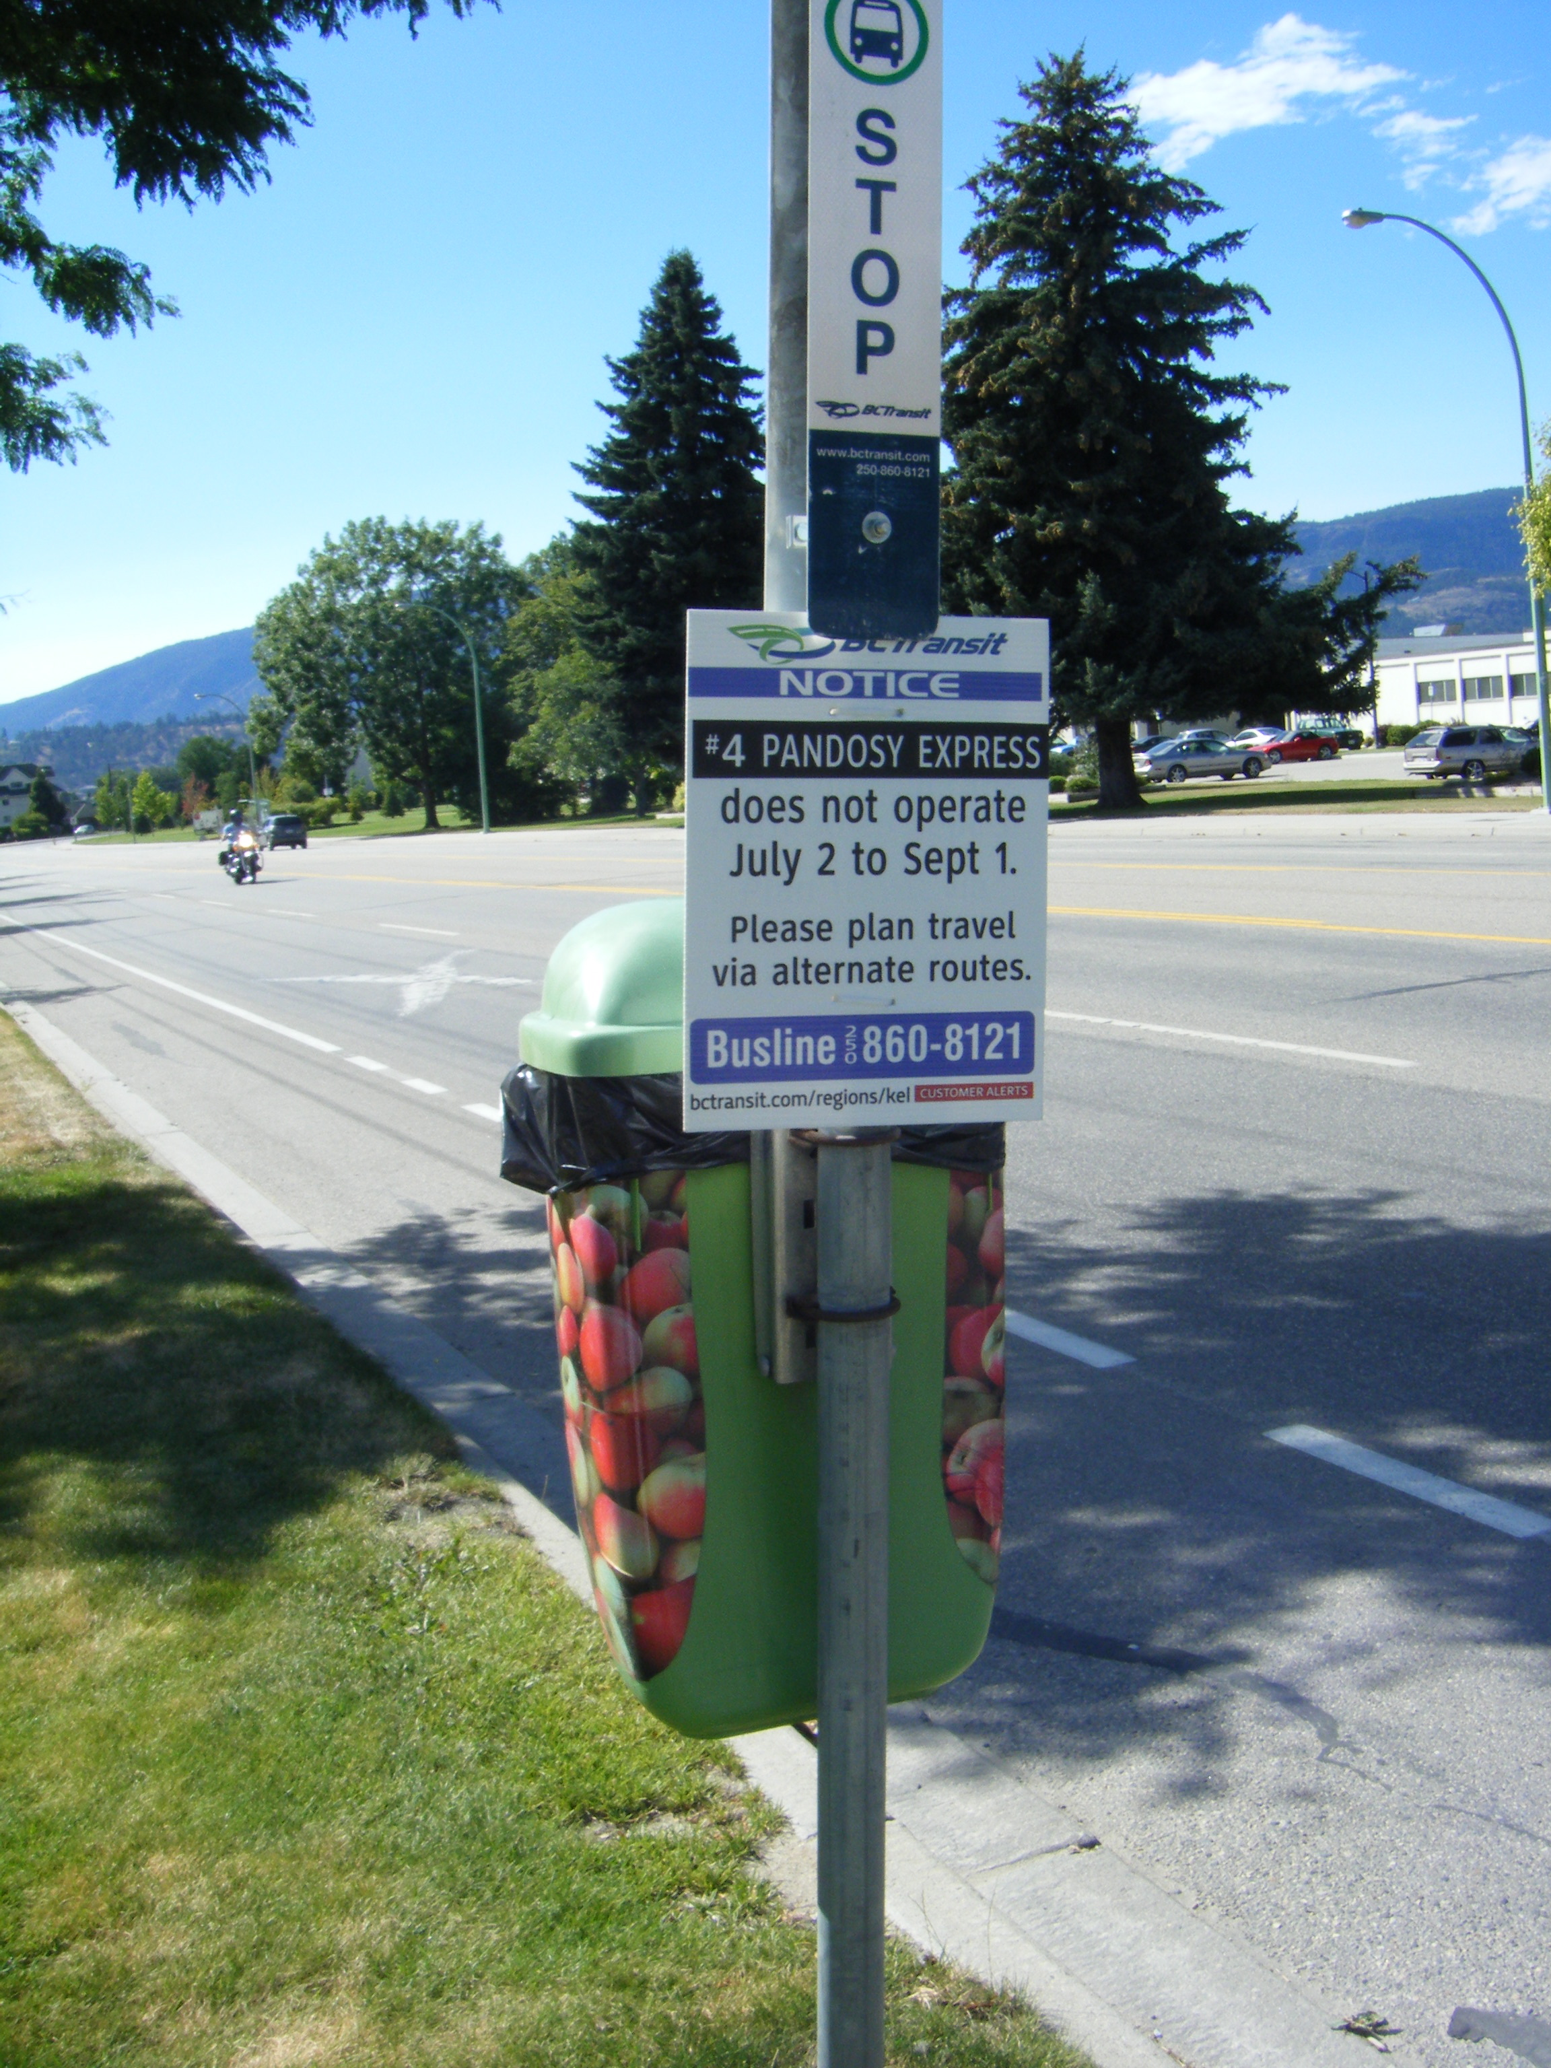
Notes:
Two views of a bus stop garbage can with an Okanagan Apple theme (archival photos)
In front of Okanagan College Campus at the corner of. KLO RD. and de Montreuil Crescent.

Slide 14
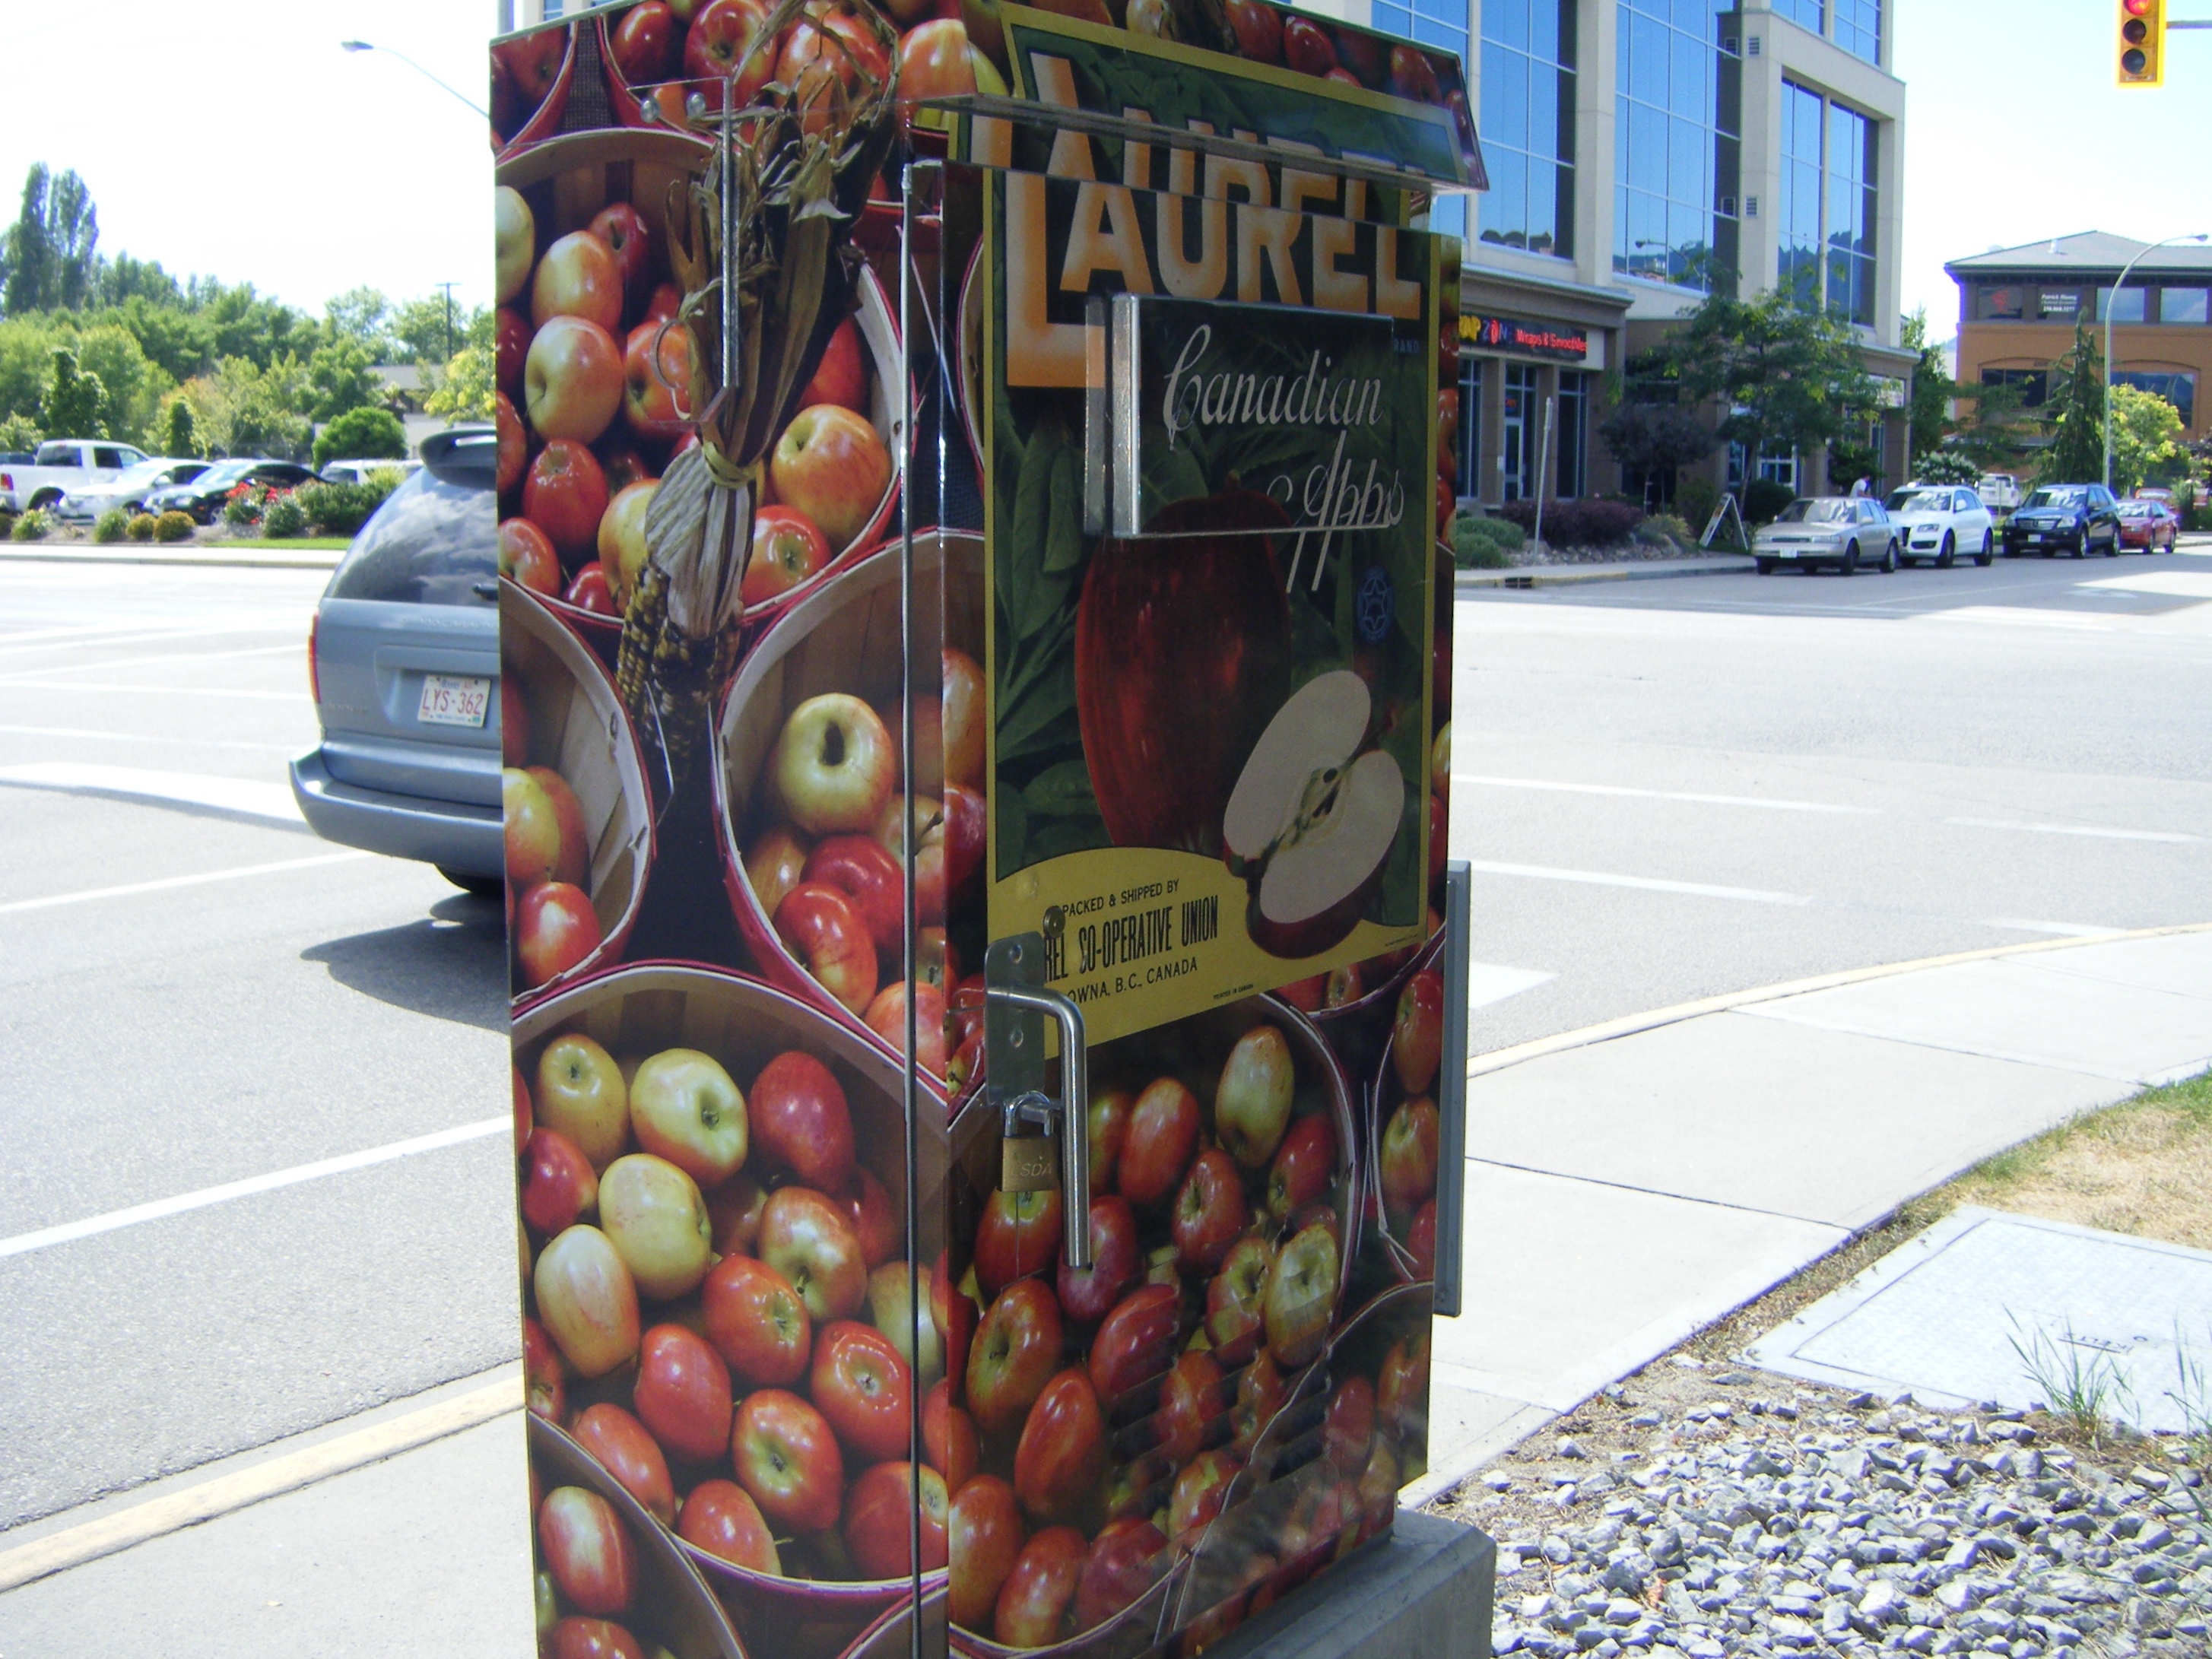
Notes:
The City of Kelowna BC was concerned that 'the unknown taggers' might abuse their property so they made their own art. "It is inexpensive to print on vinyl and only needs a hairdryer to activate the glue when applying. It keeps electric boxes and generators cool, " said the FORTIS repairman I interviewed at work on Gordon Drive. He liked the fact that the Okanagan Valley’s early fruit industry is remembered through public art as grape vineyards rapidly overtake the apple industry.

Slide 15
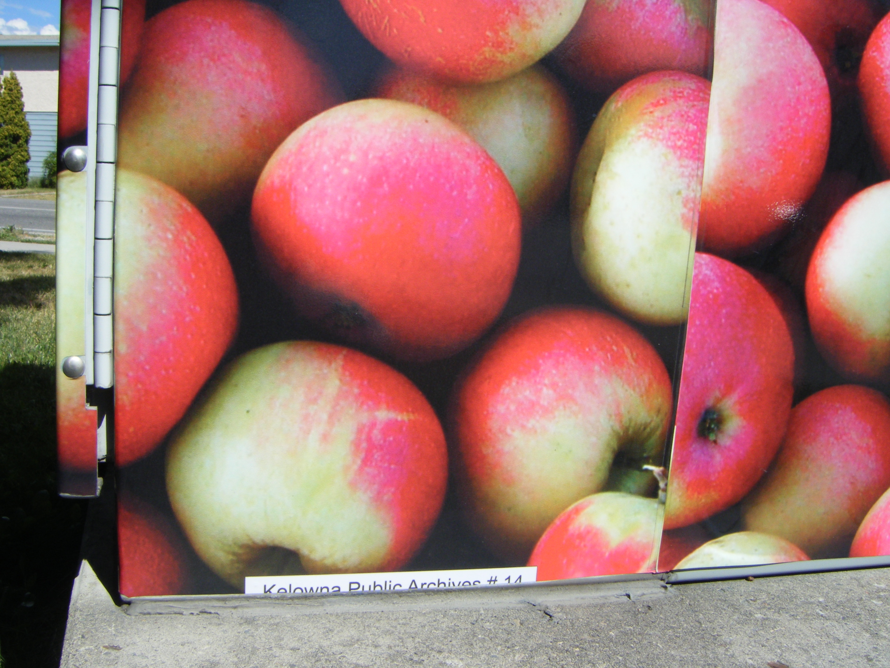
Notes:
Kelowna Museums have apple producer label archives that represent the many orchards that sold under a particular label through the packing cooperatives. Local historical societies are very active in keeping these details chronicled.

Slide 16
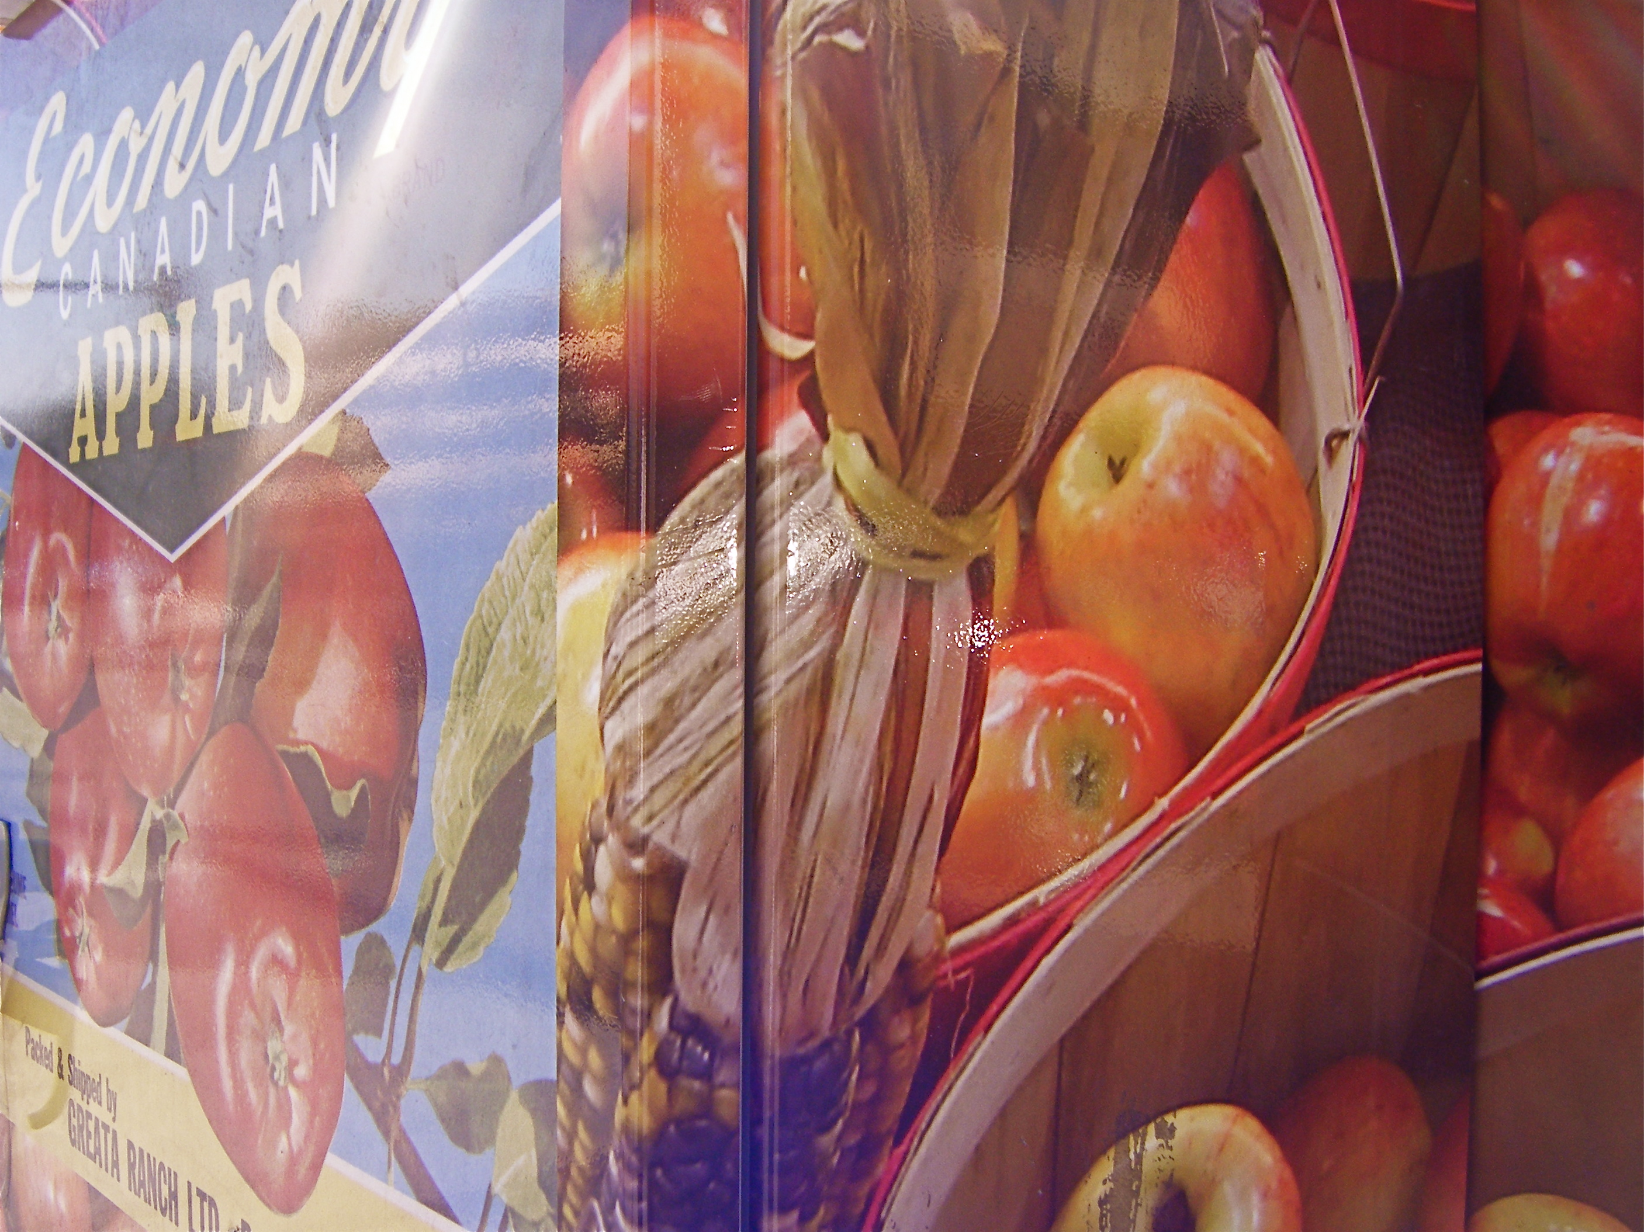
Notes:
One wants to almost pick an apple off these boxes. They are so life-like.

Slide 17
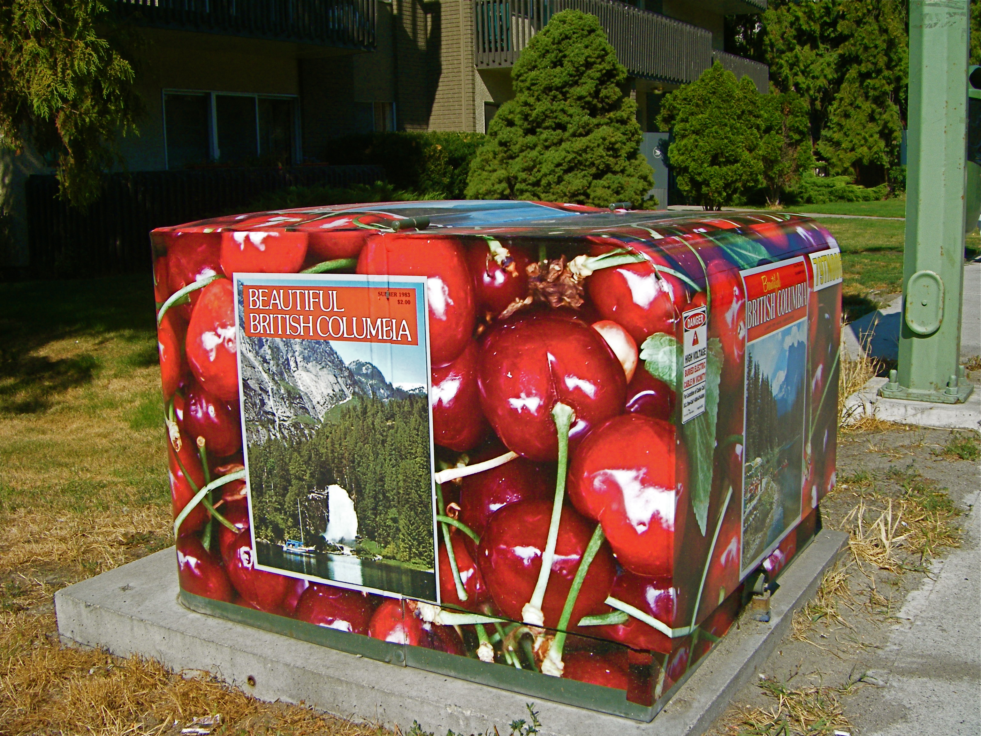
Sweet Lambert cherries
Notes:
Cherries are still grown in the region and Beautiful BC’s magazine cover on Pandosy St.

Slide 18
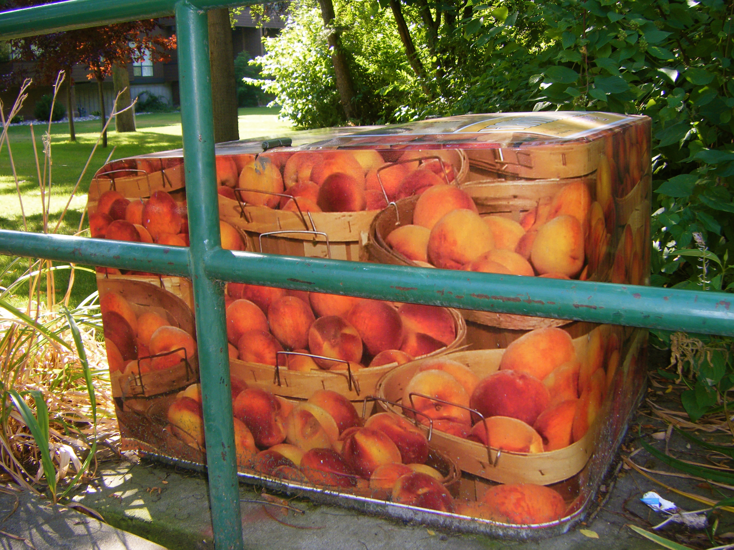
Clingstone or Freestone peaches?
Notes:
Peaches and their baskets are featured here on Mill St.

Slide 19
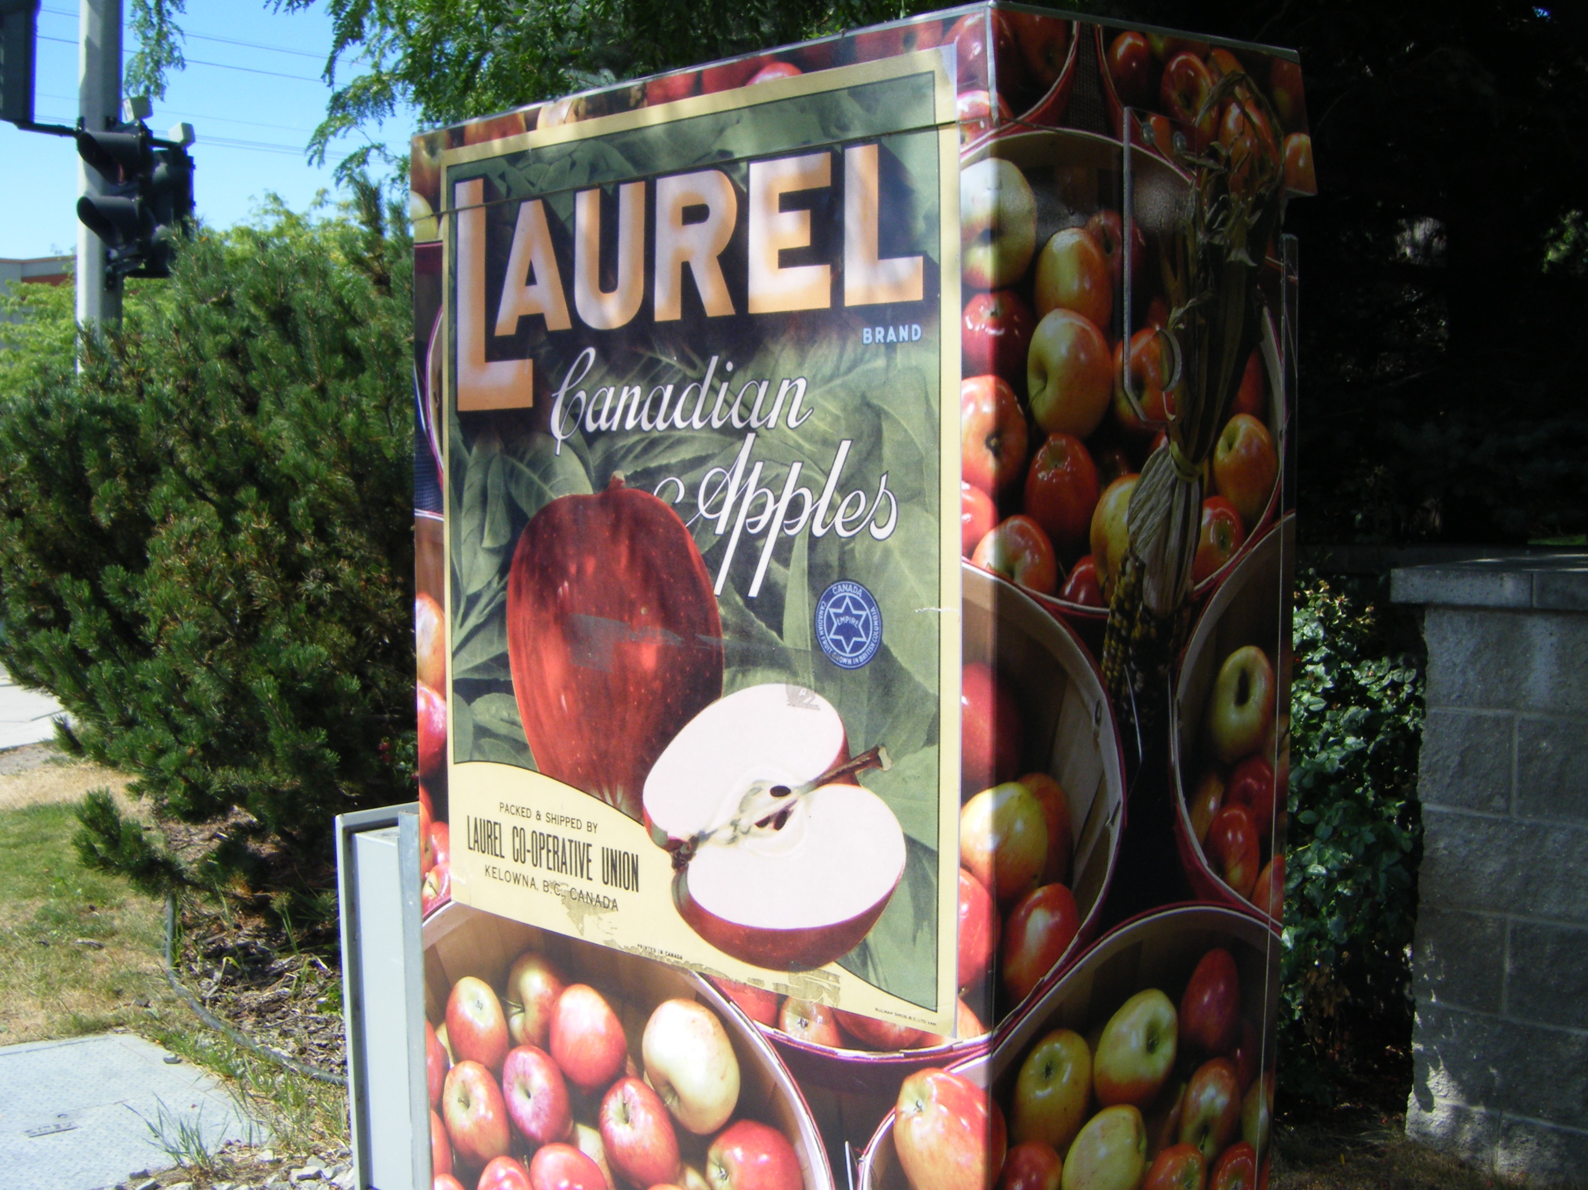
Notes:
Near a shopping mall and appartment blocks (Lanfranco and Richter St.)

Slide 20
Notes:
Steel, glass and concrete buildings are more expensive to decorate.

Slide 21
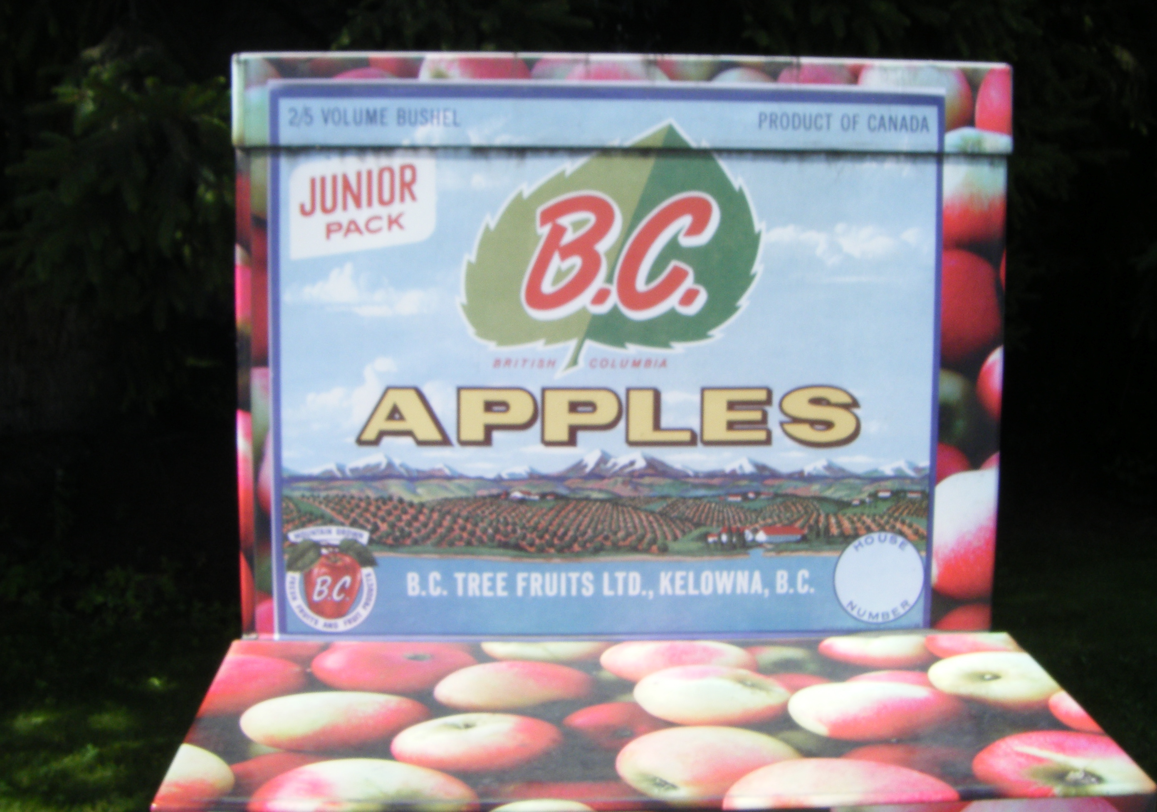
Notes:
Each producer had its own label. Now, as public art, reproductions of the early twentieth century labels may be seen without going to the local museum.

Slide 22
Notes:
The FORTIS Electric Company paid for some of the artwork but for the fruit images many catalogues, magazines and postcards have been printed. The Kelowna Packing House Museum is a good source. It seems commercial photography was also profitable in the first half of the 20th century.

Slide 23
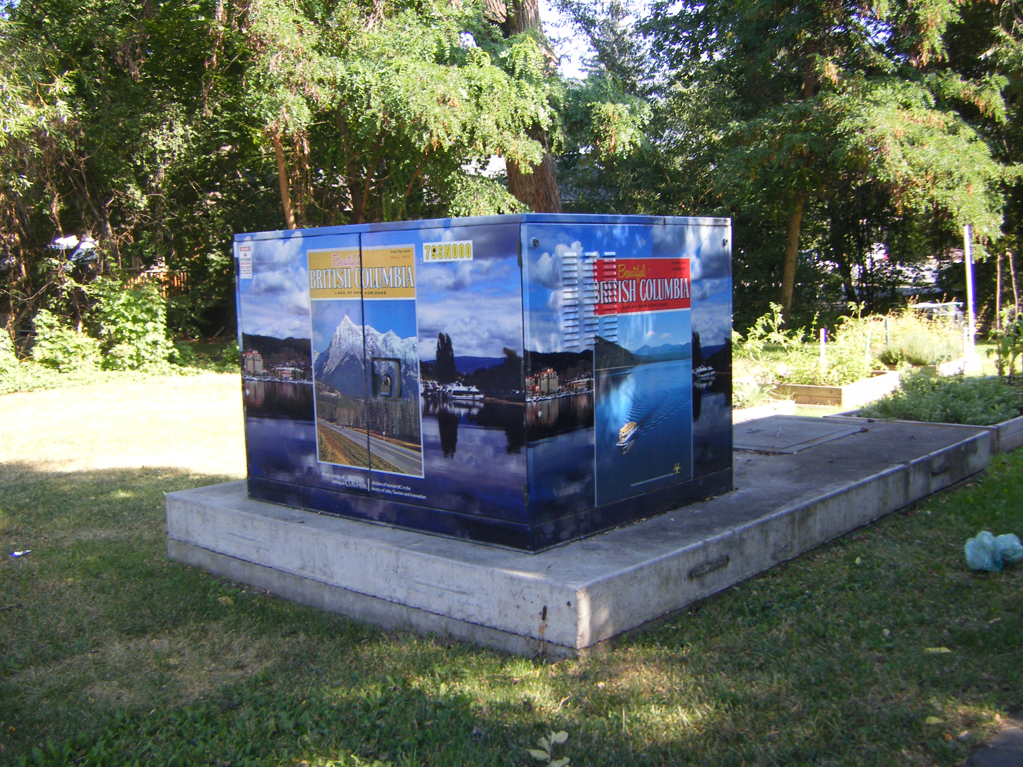
Notes:
Mountain and ocean scenes from this beautiful province are displayed. "How can I compete with God?" said one artist from Quebec who returned from B.C. without having produced a single painting.

Slide 24
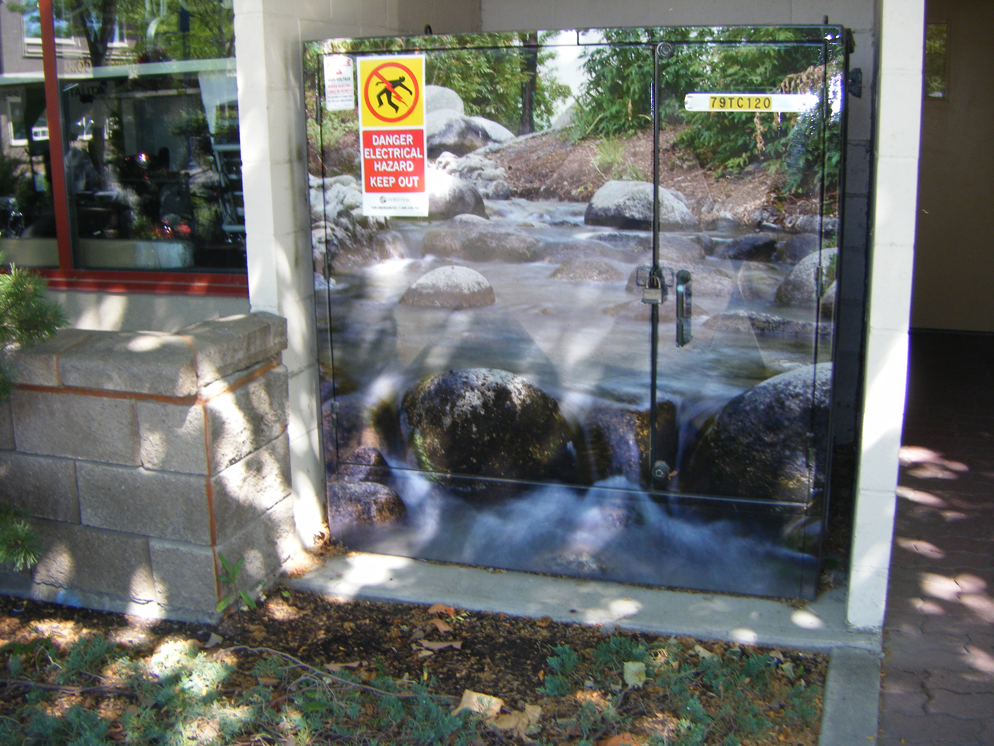
Notes:
What about a creek bed tucked into a professional building’s front entry?

Slide 25
Notes:
Or cameleon-like images in front of Now Canada appartments at 2970 Tutt Street ?

Slide 26
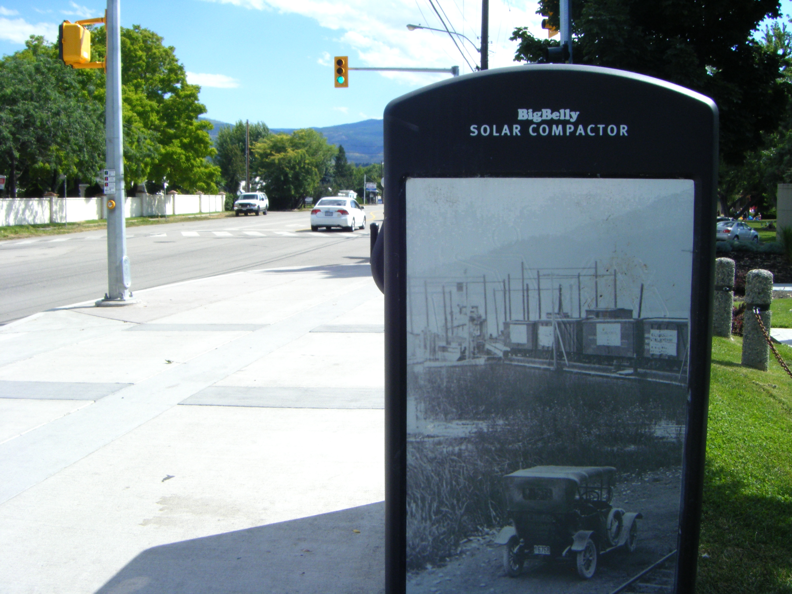
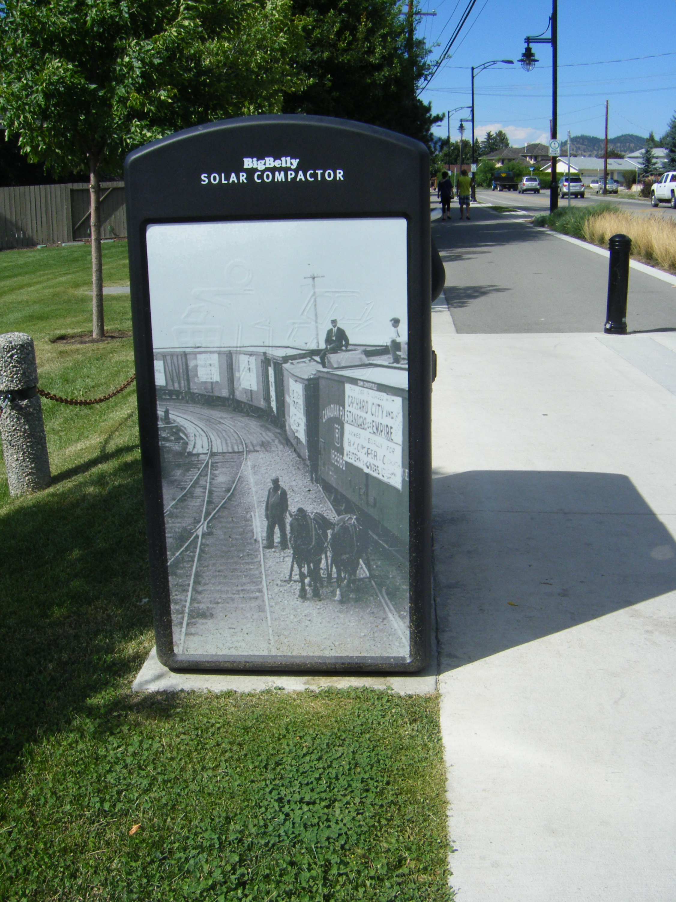
Notes:
Rotary Park’s compost boxes on Lakeshore Rd.
have incorporated historical photo scenes of Kelowna.
These Big Belly Solar Composters saved the City of Philadelphia $900,000 in waste management costs in the first year of its changeover. Theme parks such as Disney World also use these to keep boxes from overloading before workers can empty them.

Slide 27
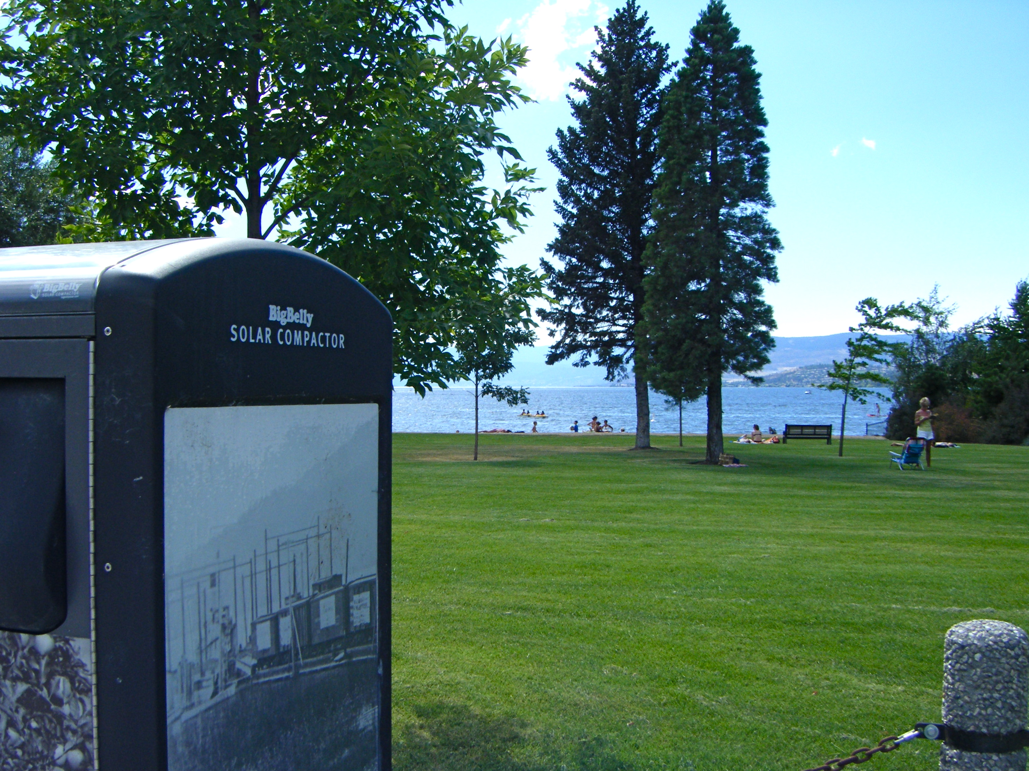
Notes:
When parks are cleaner, people enjoy their holiday in Kelowna. The city incurs less waste management costs and the tourist does his or her part.

Slide 28
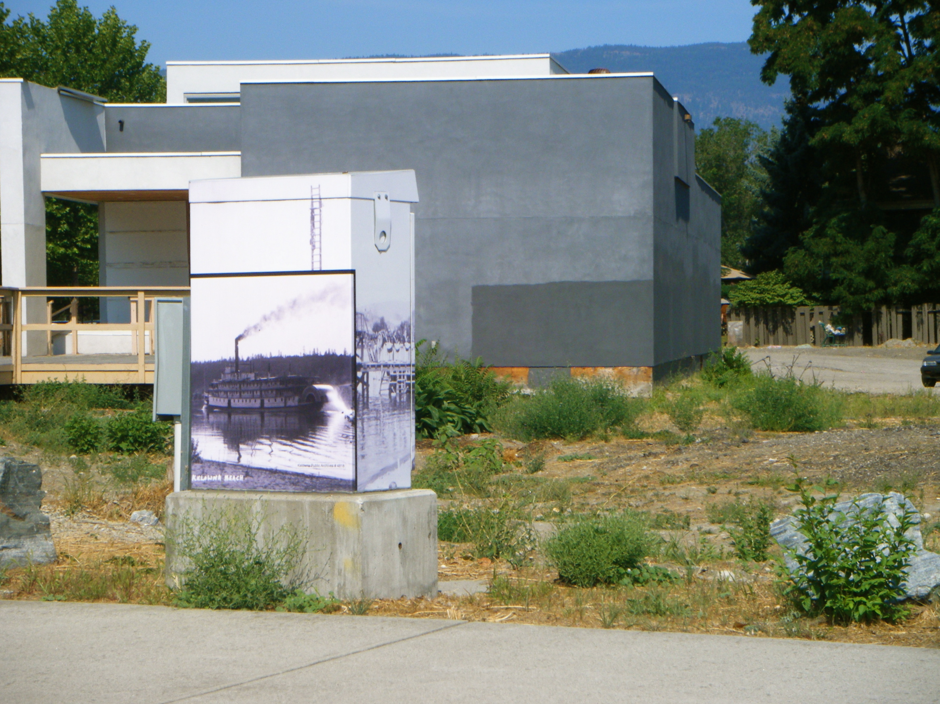
Notes:
Somehow this location didn’t work for me when I photographed the paddlewheeler ship on the box in 2012. This building was removed in 2015 because of marshy conditions below it. The box remained.

Slide 29
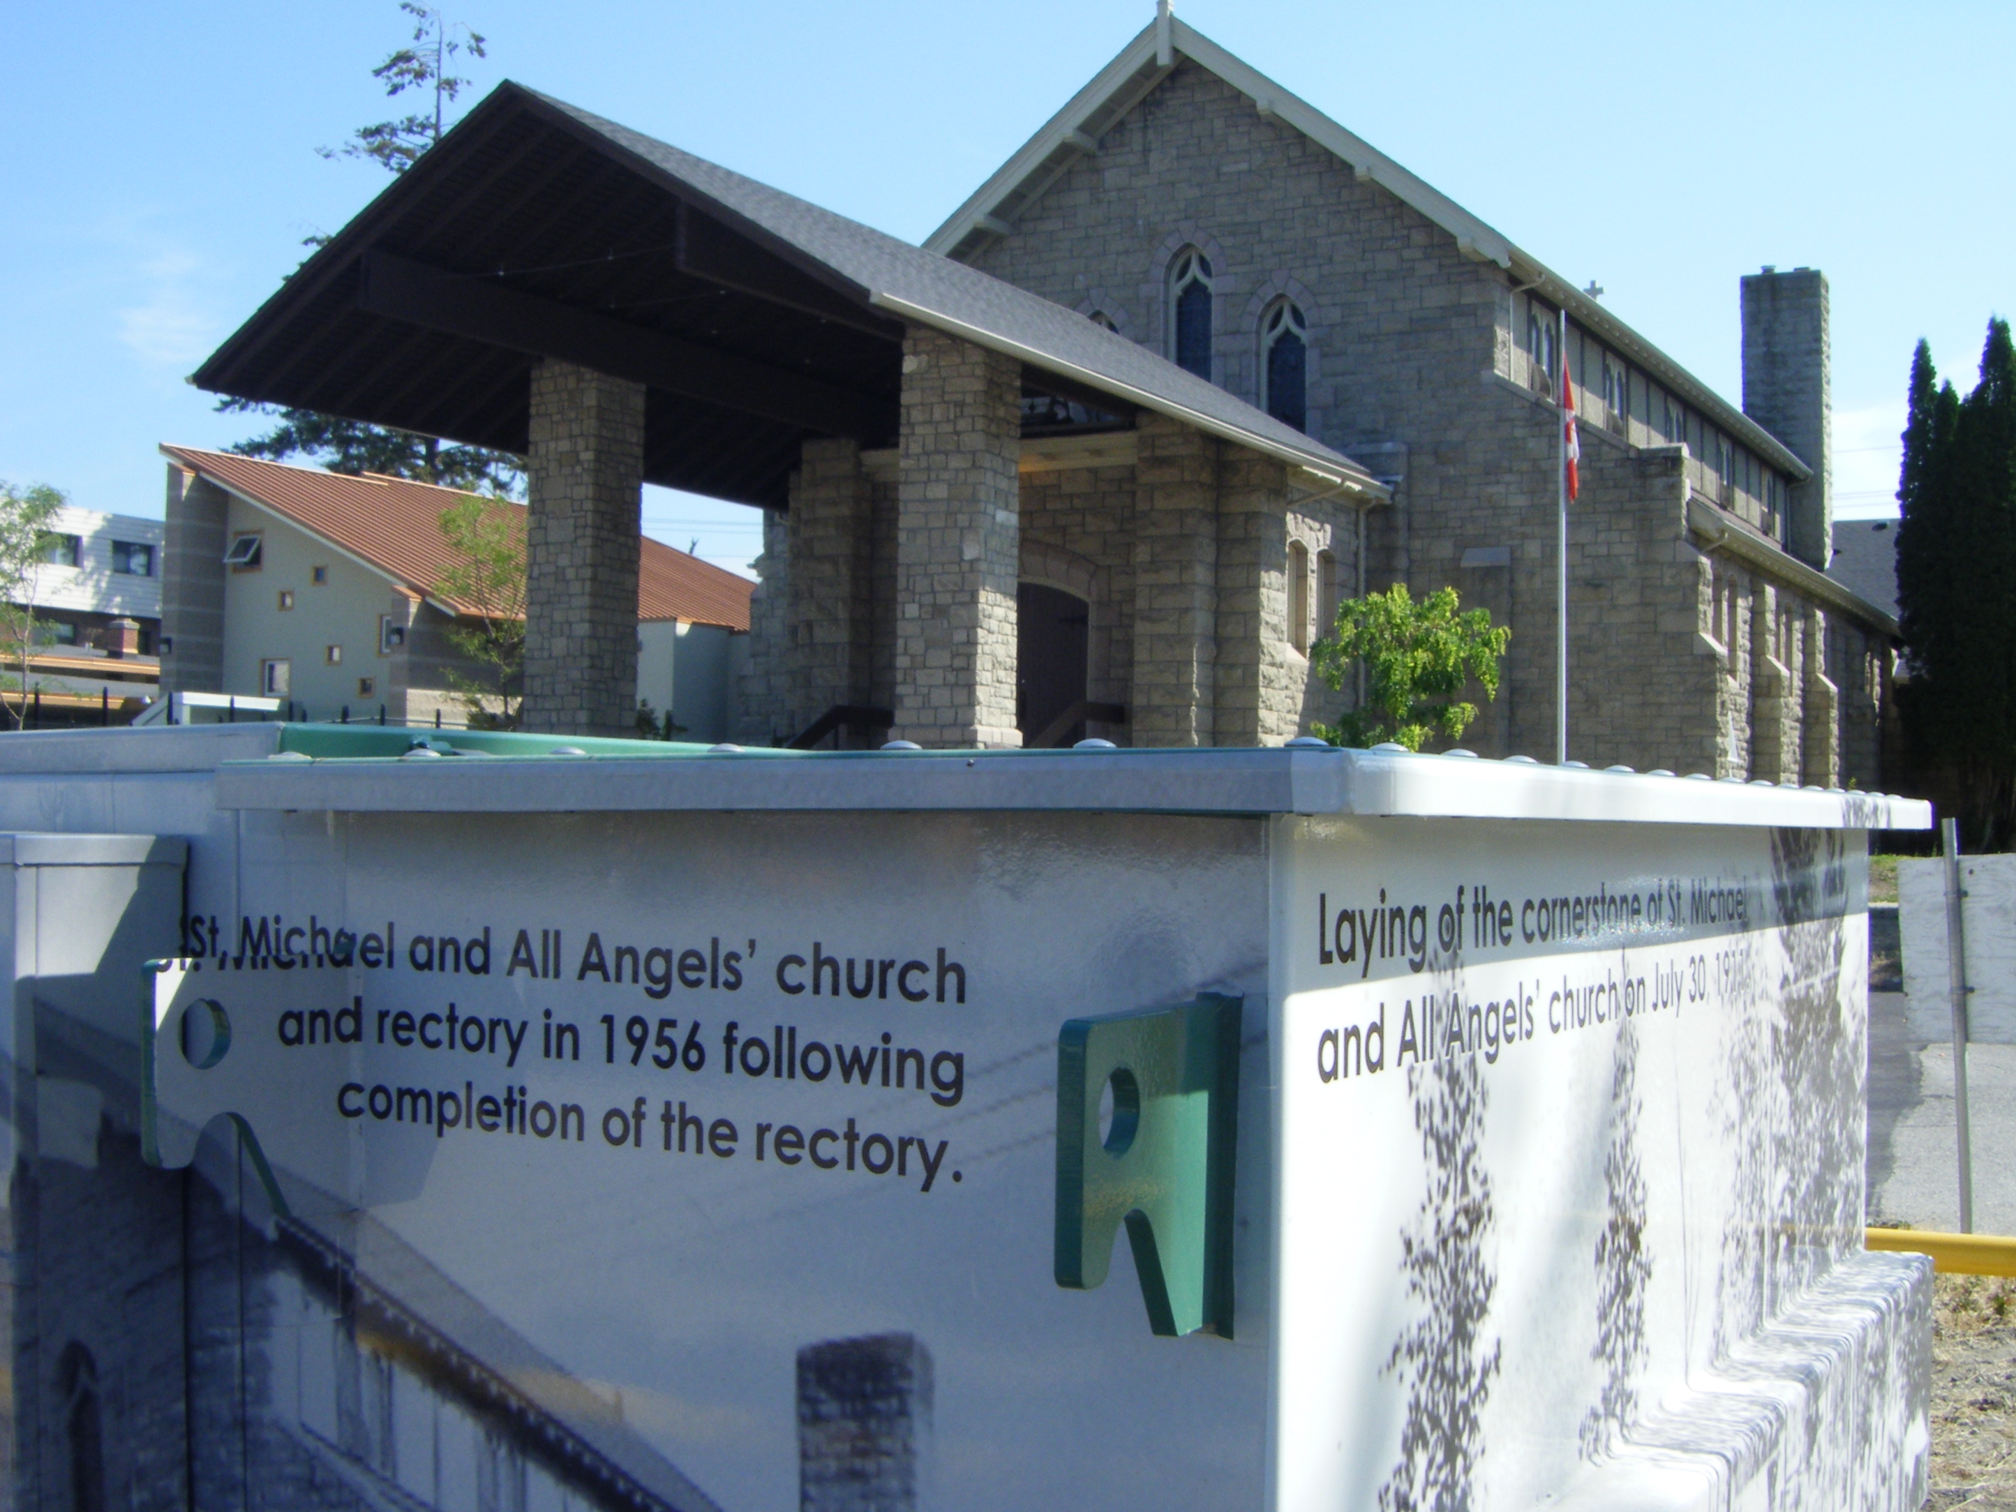
Notes:
The Church of St-Michael and All Angels has a unique way of showing its historical archive images. In its parking lot are electrical boxes with photos of the church building in its early years. This building was not far from the heart of the early apple growers' orchards.

Slide 30
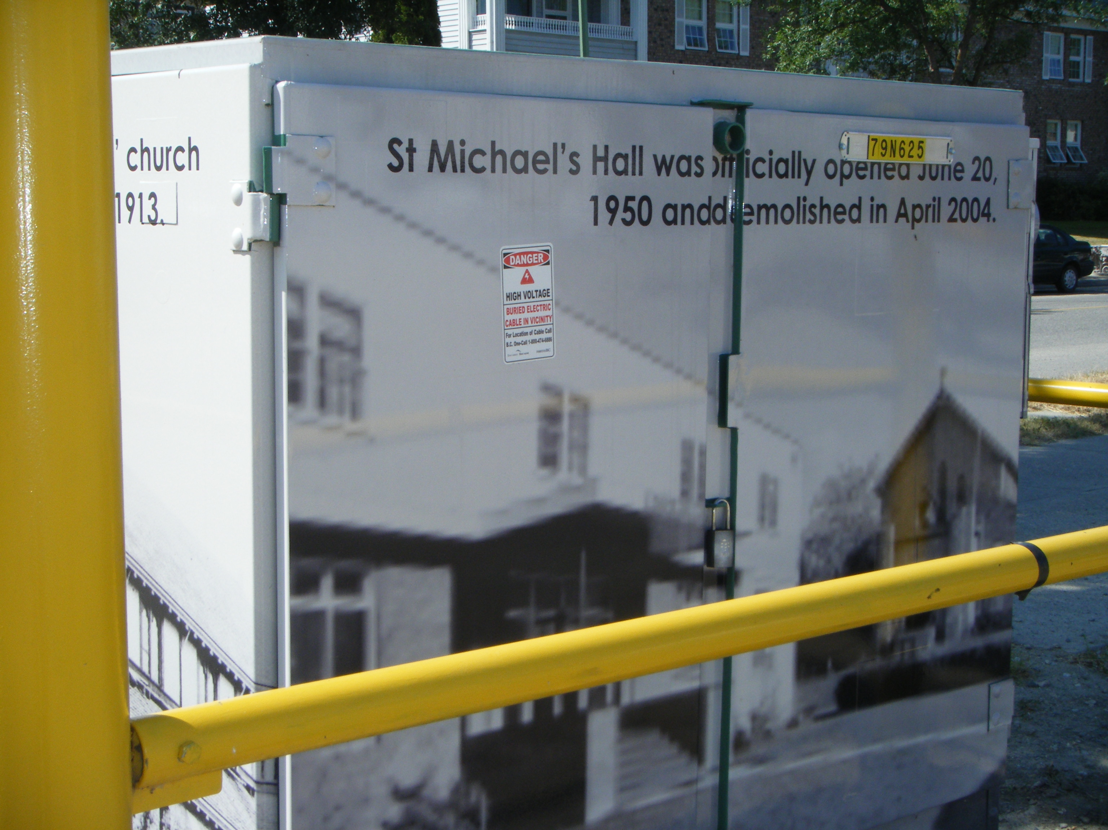
Notes:
The adjacent Hall has been newly replaced.

Slide 31
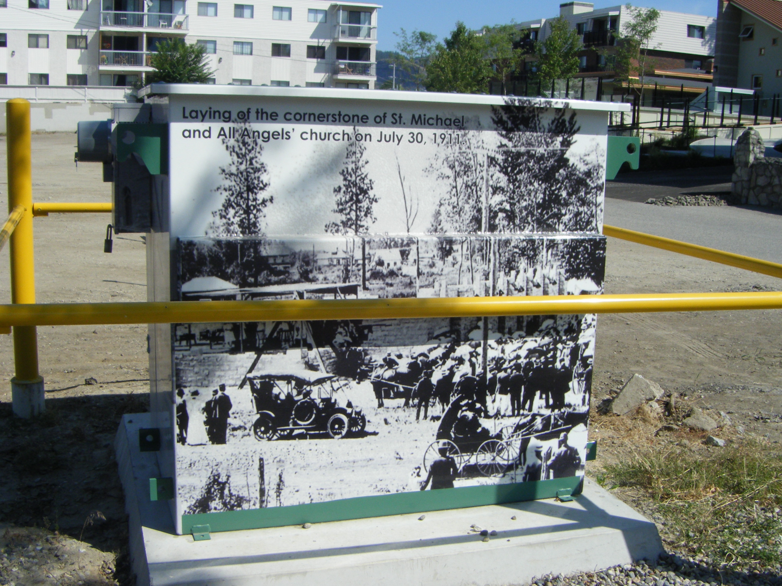
Notes:
July 30 1911 Cornerstone Laying
The 100th year celebration after the building was finished and dedicated was celebrated a year later.

Slide 32
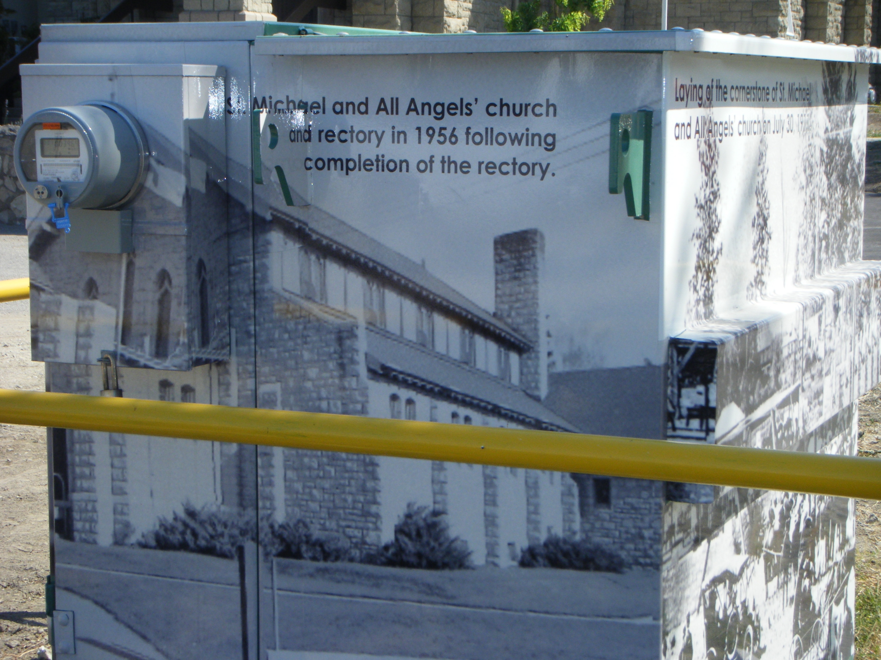
Notes:
Electric metre reader (upper left).

Slide 33
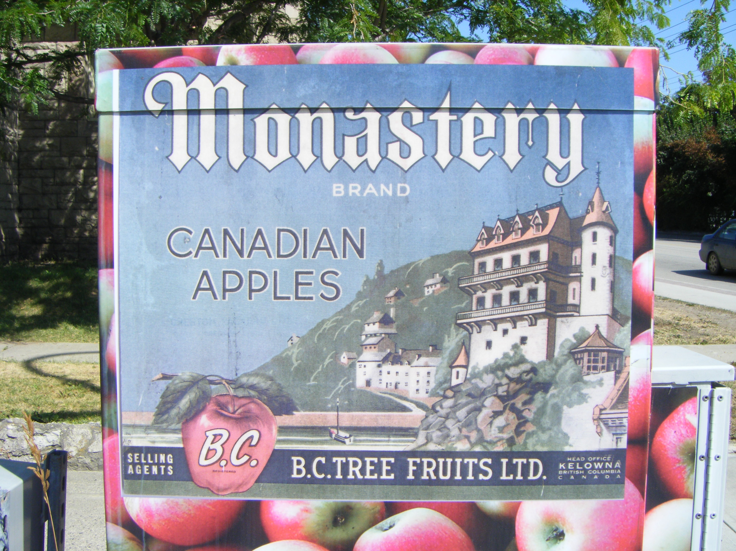
Notes:
Some of the new vineyards also reflect in their name a remembrance of monks and monasteries. Gray Monk Estate Winery in Okanagan Centre is an example where vineyards took on the name of apple orchards.

Slide 34
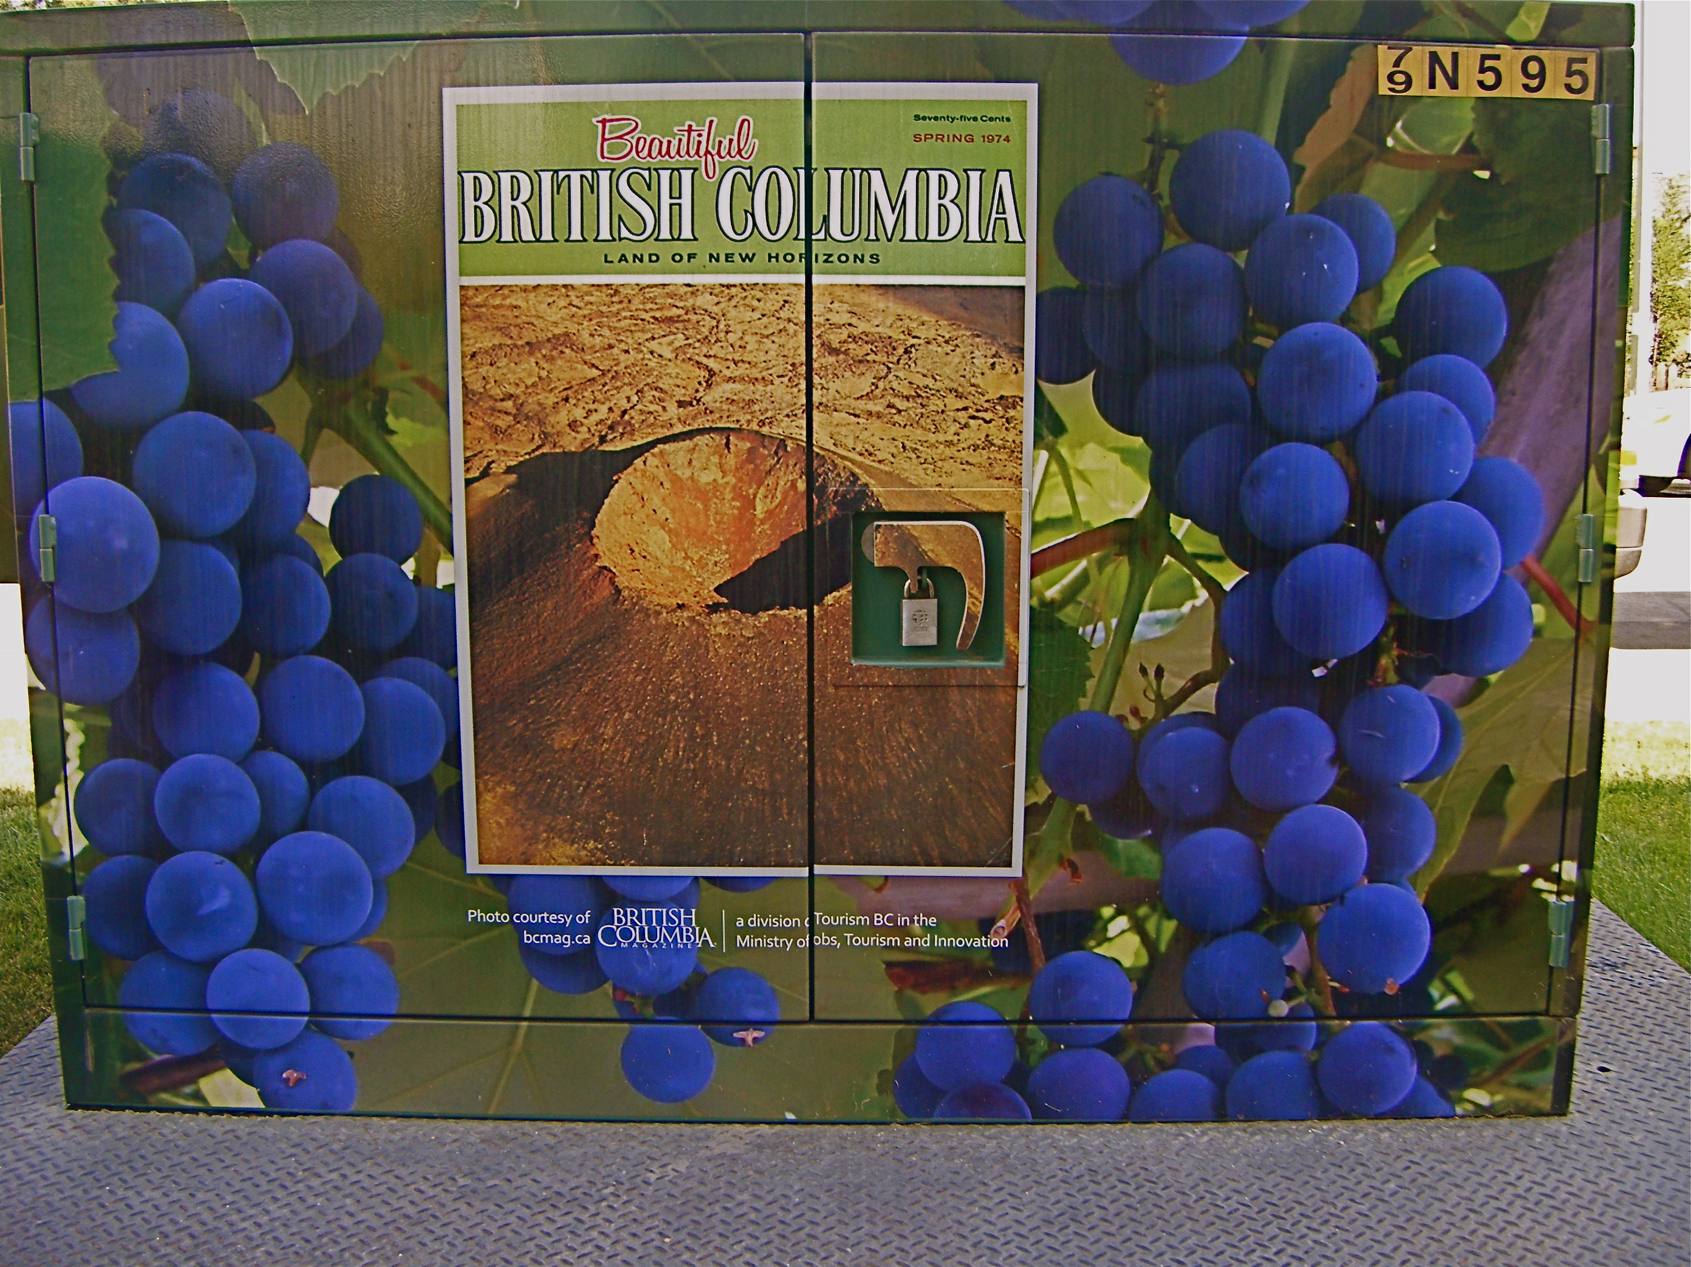
Notes:
Vineyards now fill the orchards where peaches, pears, apricots, cherries, apples, and plums once grew. This does not keep orchardists from continuing however and the market for fruit in Vancouver seems to drive competent and determined fruit growers from India to locate in the Okanagan Valley.

Slide 35
Notes:
.
So public art tells the story of the reasons Kelowna calls itself the ‘’Best Blooming Community’’.
Call Scott Isfan at Kelowna Public Works to find out more 1-250 469-8848.

